Slide 1
Wings to Words An archive of real-life accounts from World War 2

Slide 2
This story is told by: Mrs Towe (Bridge Schools English Lead)

Slide 3
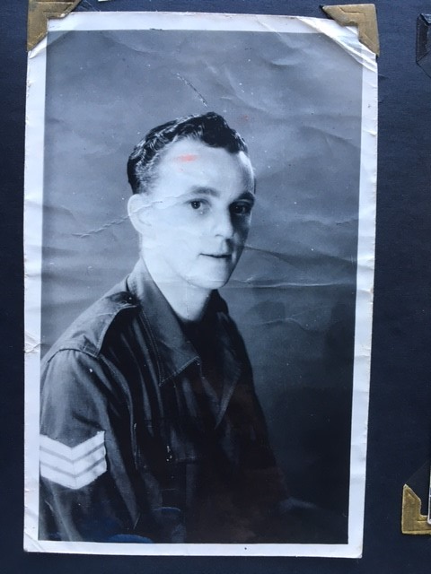
Flight Sergeant May
RAF: Squadrons 77 and 155
My Grandfather, Alfred May, joined the RAF in World War 2 and flew to many countries. He was from St Germans in Cornwall.

Slide 4
A PICTURE IS WORTH A THOUSAND WORDS
Grandad kept this journal. He added his photos and notes to it during the overseas missions throughout the war. He never showed anyone the book and he never talked about the war. This book had been kept in a cupboard and I only recently found out some of the stories about his time serving in the RAF. He loved writing and keeping records and was a keen photographer, so luckily some of the pictures and notes helped me to get a glimpse into his experiences….

Slide 6
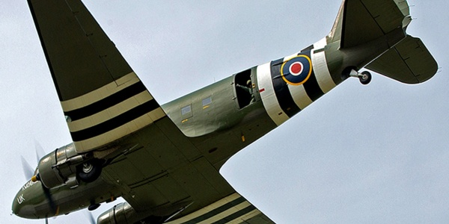
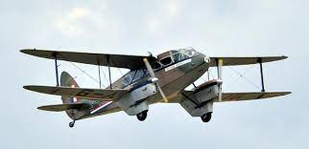
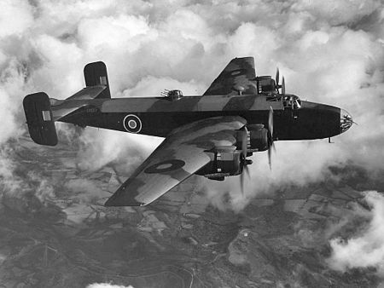
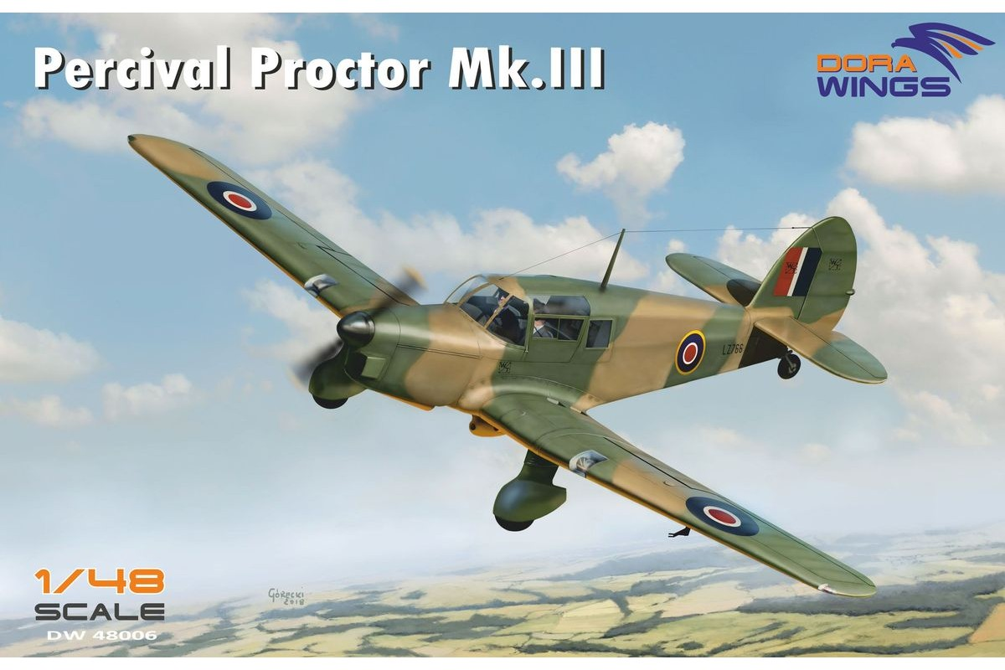
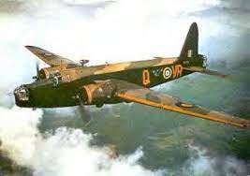
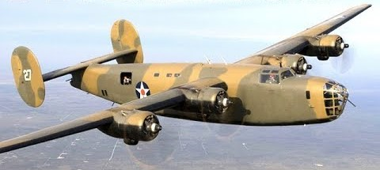
His journal lists the planes that he flew in during the war as:
Dakota De Havilland Dominee Halifax Bomber
Liberator Percival Proctor Wellington Bomber

Slide 7
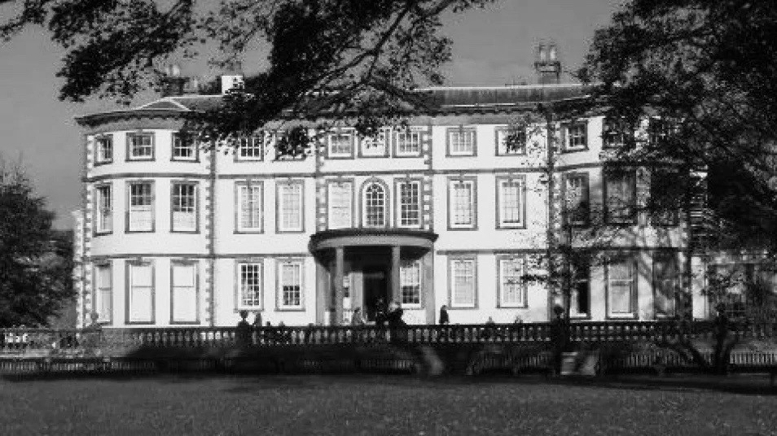
A Narrow Escape…
One of Grandad’s planes was shot down over the sea. The pilot landed skillfully on the water, allowing the crew time to climb aboard a hooded life-raft, where they were lost at sea for a long time. When they were eventually found, they were very ill and taken to a RAF Convalescence hospital in Yorkshire. My Grandad never talked about the war and we only know this because my Grandmother found out when they visited Sewerby Hall in Yorkshire on holiday many years later and Grandad knew the house…

Slide 8
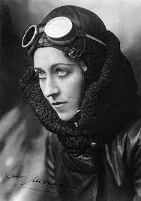
The house today..
Sewerby House in Bridlington was commissioned by the RAF in World War 2 as a hospital for those in service to convalesce.
By co-incidence, it is also now the Amy Johnson Museum. Amy Johnson was a pilot in world war 2 and she was the first female pilot to fly alone from England to Australia.
As I have only recently found out this story about my Grandad, I plan to visit Bridlington next summer!

Slide 9
FACT OF INTEREST:
Of 125,000 aircrew who served in the strategic bomber force between 1939 and 1945, 55,000 were killed and another 18,000 wounded or taken prisoner, a casualty rate of 60 per cent. Statistically, there was no more dangerous occupation during the war, except for that of U-boat crewman. The chance of being killed on a typical operation was one in 20, while the standard “tour” undertaken by a crew consisted of 30 ops.

Slide 10
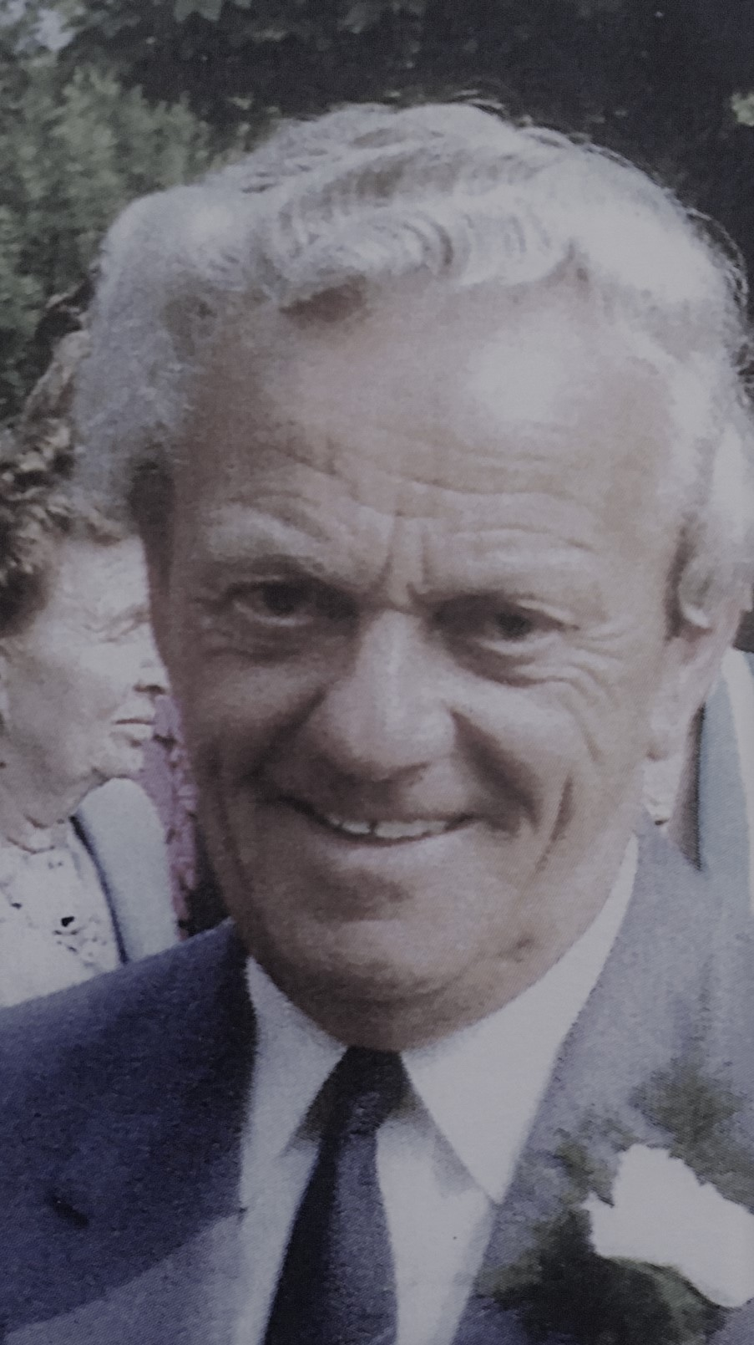
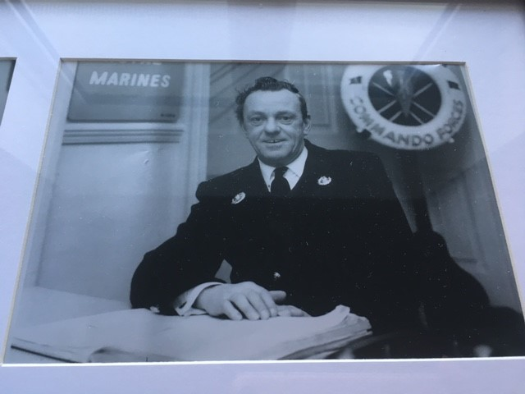
Flight Sergeant Alfred May
Grandad later went on to work for the MOD (Military of Defence). I remember him talking about this! I feel quite sad that I know so little about his time in World War 2, but I understand why it must have been hard for him to talk about these times. I feel lucky to have had such a lovely Grandfather and the journal is very special. I’m very proud of him: as Winston Churchill said in reference to the RAF Pilots and bomber crews who helped to establish air superiority over England; “Never in the field of human conflict was so much owed by so many to so few”.

Slide 11
On the next slides are some images from ‘Tail-end Charlie’ that you could use for your backgrounds if you wanted to. Just right click, copy and paste!

