Slide 1
YEAR 5 SPELLINGS
Spring 1

Slide 2
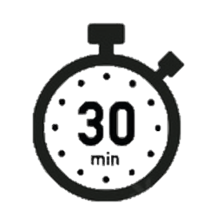
Spell it out
sensible | thistle | torrential | transferring | absent
spacious | thought | tough | well-known | accent
special | tolerant | transferred | absence | affect
Day 1

Slide 3
Spell it out
aisle | altar | ascent | bough | conceited
allowed | alter | assent | bridge | conceiting
aloud | although | bad-tempered | ceiling | conceits
Day 1

Slide 4
Spell it out
conceiving | co-operate | dependable | different | effect
conferring | coughing | dictionary | disastrous | exaggerate
confident | decent | difference | dough | excellent
Day 1

Slide 5
YEAR 6 SPELLINGS
Spring 1

Slide 6
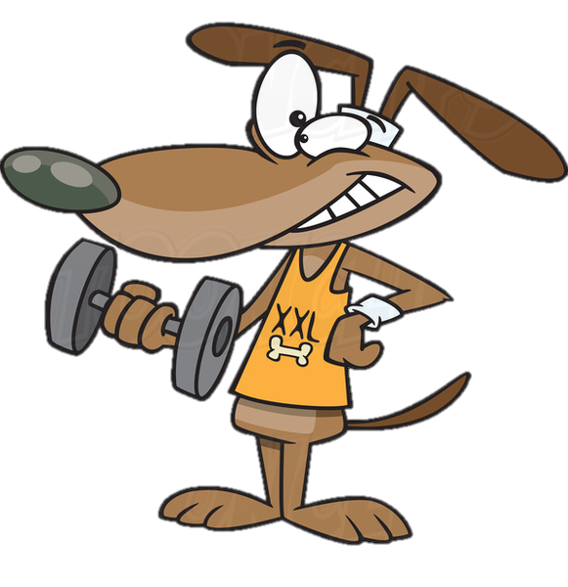
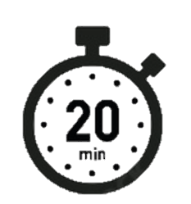
Word workout
deceiving | definite | design | doubt | equip
defensible | delicious | determined | dumb | expectancy
defer | dependable | divisible | elegancy | extravagancy

Slide 7
Word workout
fancy | handkerchief | independent | lesson | limb
furious | hospitable | infer | license | misthought
gnome | hour | lessen | licence | nutritious

Slide 8
obedient | practise | practice | preference | repetitious
ridiculous | seam | seem | stop-off | subtle
thorough | thumb | torturous | transference | unofficial
Phonemes, Syllables & Sound Associations
TRICK PART:
Silent b
thumb
subtle

