Slide 1
YEAR 5 SPELLINGS
Spring 1

Slide 2
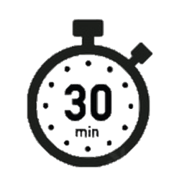
Spell it out
muscle | occupy | peace | plough | possible
mysterious | opportunity | perceive | ploughing | power-driven
neighbour | paw | piece | poor | quick-thinking
Day 1

Slide 3
Spell it out
racial | referee | sandwich | social | sugar-free
reasonable | reference | so | spatial | terrible
receipt | reliable | sew | suffering | thoughtfully
Day 1

Slide 4
Spell it out
through | weak | absorbent | ambitious | asocial
vicious | Wednesday | accident | answer | balance
visible | week | adorably | applicably | bean
Day 1

Slide 5
YEAR 6 SPELLINGS
Spring 2

Slide 6
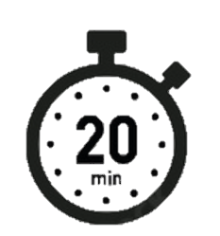
Word workout
fancy | handkerchief | independent | lesson | limb
furious | hospitable | infer | license | misthought
gnome | hour | lessen | licence | nutritious

Slide 7
obedient | practise | practice | preference | repetitious
ridiculous | seam | seem | stop-off | subtle
thorough | thumb | torturous | transference | unofficial
Phonemes, Syllables & Sound Associations
TRICK PART:
Silent b
thumb
subtle

Slide 8
unsocial | weather | witch | antisocial | breakthrough
waist | whether | wreck | autumn | bridle
waste | which | yacht | biscuit | bridal
Phonemes, Syllables & Sound Associations
TRICK PART:
Silent letters
cht says /ot/
wreck
autumn
yacht

