Slide 2
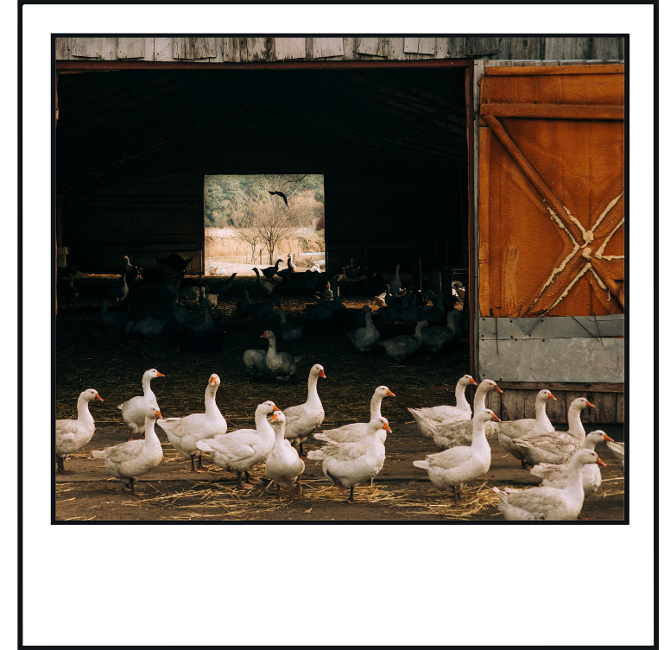
Story-Writing Prompt 1
The Gaggle of Geese
Use this picture to write
a story.
Show Picture
Your story must include a problem that involves a pond.
Next

Slide 3
Story-Writing Prompt 2
Write a Letter
Write a letter to somebody that you have
not seen in a while.
In your letter, tell them about what you
have done since you last saw each other.
Remember to ask them about their life, too.
Next

Slide 4
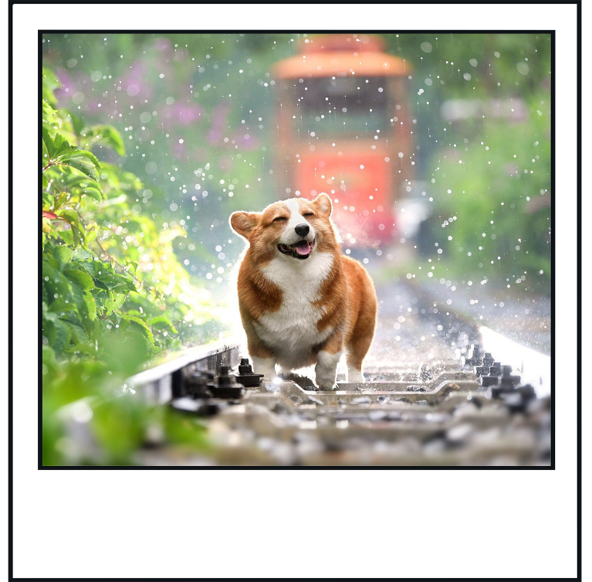
Story-Writing Prompt 3
My Happy Day
Use this picture to write
a poem.
Show Picture
Your poem should be a shape poem. It does not have to rhyme.
Next

Slide 5
Story-Writing Prompt 4
The Magic Tap
Something very strange happened to me when
I turned on the tap to wash my hands.
Instead of water…
Continue the story.
What will come out of the tap?
What will happen because of that?
Next Step
Next

Slide 6
Story-Writing Prompt 5
Horrid Hotel
Use this picture to write
a pretend recount.
Show Picture
Your recount should explain what happened on the night that you stayed at the Horrid Hotel.
Next

Slide 7
Story-Writing Prompt 6
Write a Postcard
Pretend that you are on your dream holiday.
Write a postcard to someone you know telling them about everything you have done.
Remember to describe where you are.
Next

Slide 8
Story-Writing Prompt 7
SPLASH!
Use this picture to write
a story.
Show Picture
Your story must include a balloon, a map and a tree.
Next

Slide 9
Story-Writing Prompt 8
One Spooky Night
Last night was the spookiest night of my life!
You won’t believe what happened.
Continue the story.
Why was the night so spooky?
How did it turn out in the end?
Next Step
Next

Slide 10
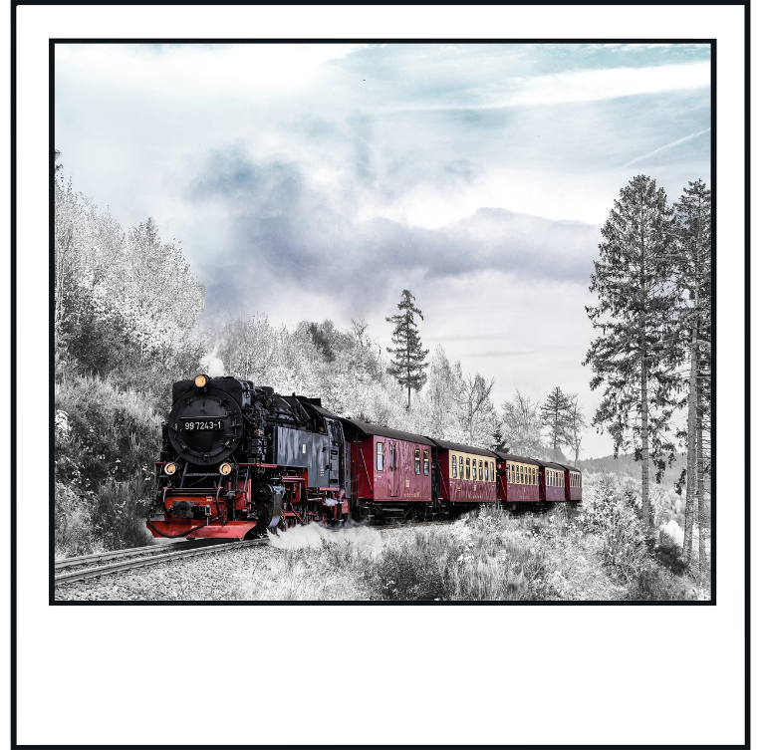
Story-Writing Prompt 9
A Snowy Adventure
Use this picture to write
a poem.
Show Picture
Your poem should be an acrostic poem. It does not have to rhyme.
Next

Slide 11
Story-Writing Prompt 10
Make a Leaflet
Pretend that your house is a place that people
would love to visit.
Make a leaflet telling tourists about all of the
fun things you can do there. You can even
make some up!
Remember to include directions so they know
how to find you.
Next

Slide 12
Story-Writing Prompt 11
An Interesting Meeting
Use this picture to write
a pretend newspaper
Show Picture
report.
Your newspaper report should retell what happened on the day that everyone became invisible.
Next

Slide 13
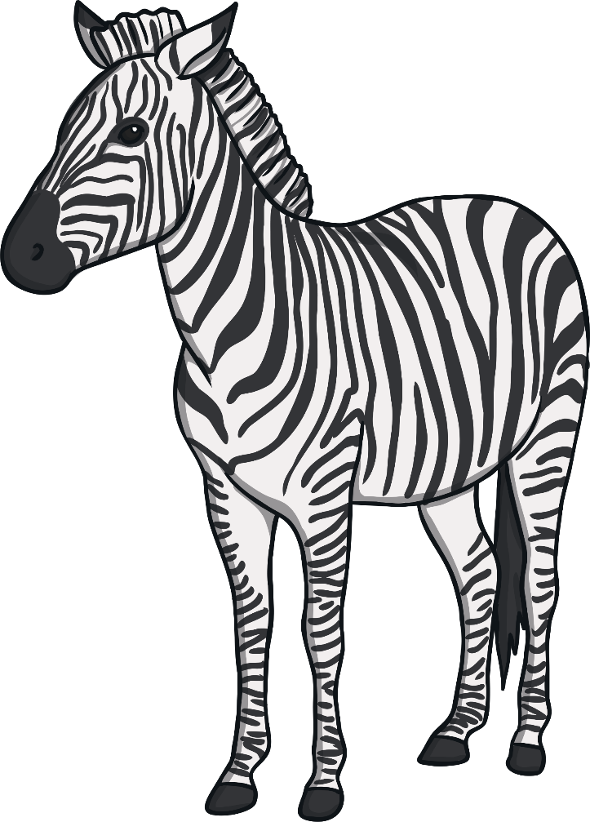
Story-Writing Prompt 12
Talk to the Animals
“Did you just speak?” Dan gasped.
“Of course I did!” replied the zebra.
Continue the story.
How is the zebra able to speak?
What else can the zebra do?
Next Step
Next

Slide 14
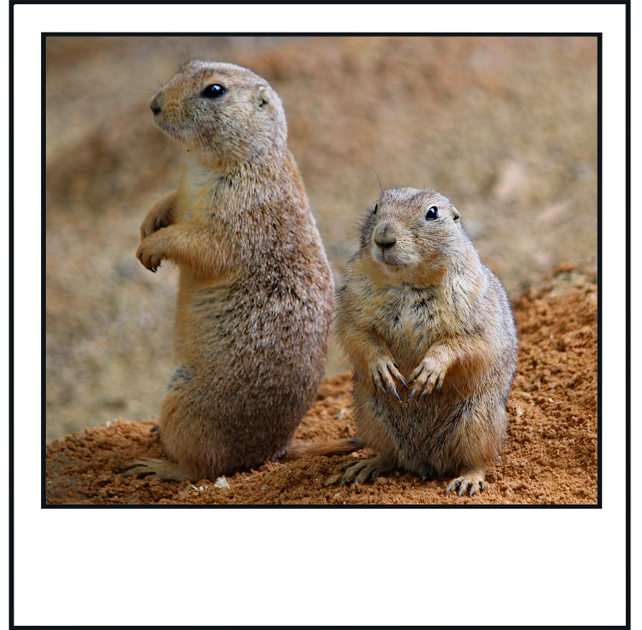
Story-Writing Prompt 13
Meerkat Rescue
Use this picture to write
a story.
Show Picture
Your story must include a resolution that involves a monkey.
Next

Slide 15
Story-Writing Prompt 14
Write a Biography
Think about a person that you look up to.
It can be someone you know or someone
famous.
Write a biography about their life.
Remember to present the biography in an
interesting way.
Next

Slide 16
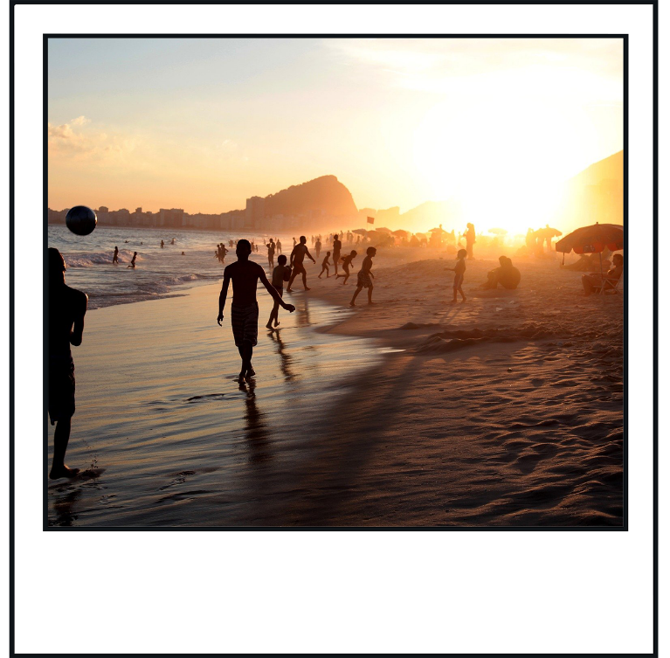
Story-Writing Prompt 15
Fun in the Sun
Use this picture to write
a poem.
Show Picture
Your poem should rhyme.
Next

Slide 17
Story-Writing Prompt 16
The Mysterious Door
The door was unlike anything I’d seen before.
A strange, red glow shone through the cracks
around it.
Suddenly, the handle began to move.
Continue the story.
What was causing the red glow?
Who was moving the handle?
Next Step
Next

Slide 18
Story-Writing Prompt 17
Tell Me How
Use this picture to write
a set of instructions.
Show Picture
Your instructions should explain to an alien how to make your favourite meal.
Next

Slide 19
Story-Writing Prompt 18
Persuade Me
Invent a new gadget that would be helpful
to have at home.
Write an advert that persuades someone else
to buy it.
Remember to make your gadget seem really
exciting.
Next

Slide 20
Story-Writing Prompt 19
Mystery Manor
Use this picture to write
a story.
Show Picture
Your story must explain why nobody lives in the house anymore.
Next

Slide 21
Story-Writing Prompt 20
My New Pet
I’m keeping a secret. I have a new pet.
I can’t tell anyone about it because my new
pet is not an ordinary pet. My new pet is…
Continue the story.
What is your new pet?
What will you and your new pet do together?
Next Step
Next

