Slide 2
Monday
Tuesday
Wednesday
Thursday
Friday

Slide 3
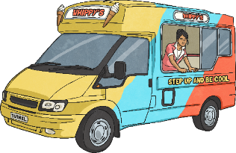
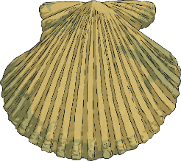
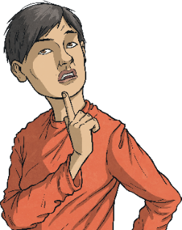
Menu
Week 1 Monday
Place Value
Fractions
Reveal answer
Reveal answer
Write four hundred and thirteen thousand and forty-seven in numerals.
What number is hidden in these equivalent fractions?
1
=
7
4
28
413 047
Problem Solving
Reveal answer
Write the first three common multiples of 3 and 8:
+ and −
Reveal answer
24
72
37 091 + 1100 = 38 191
48
Reveal answer
39 800 - 900 =
38 900
Reasoning
0.12 < 0.06 because 1 < 6.
× and ÷
Reveal answer
Use a written method to solve this calculation:
8872 × 8 = 70 976
Is Jamil correct? Explain your reasoning.

Slide 4
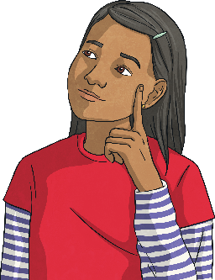
Menu
Week 1 Tuesday
Place Value
Fractions
Reveal answer
Reveal answer
What is this number? CLXXIV
What number is hidden in these equivalent fractions?
3
=
9
5
15
174
Problem Solving
Reveal answer
A shape has 2 more sides than a hexagon. What is it called?
+ and −
Reveal answer
1 8 9 2 6 + 6 0 2 7 5
An octagon
7 9 2 0 1 1 1 1
Reasoning
If I count on from 15 in steps of 8 I will say the number 528.
× and ÷
Reveal answer
Use a written method to solve this calculation:
2005 ÷ 5 = 401
Is Saniya correct? Explain your reasoning.

Slide 5
Menu
Week 1 Wednesday
Place Value
Fractions
Reveal answer
Reveal answer
Round 12 674 to the nearest ten.
Convert this mixed number into an improper fraction:
5
1
=
11
2
2
12 670
Problem Solving
Reveal answer
Complete this calculation:
+ and −
Reveal answer
3.8 + 0.27 = 5.37 - 1.3
26 940 + 600 = 27 540
Reveal answer
10 000 - 2800 =
7200
Reasoning
An angle measuring 205° is a reflex angle.
× and ÷
Reveal answer
Use a written method to solve this calculation:
3563 × 5 = 17 815
Is Jamil correct? Explain your reasoning.

Slide 6
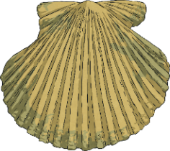
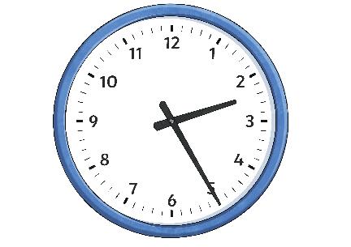
Menu
Week 1 Thursday
Place Value
Fractions
Reveal answer
Reveal answer
Count forwards in steps of 100 from 3862. What are the first three numbers?
Use the greater than or less than symbols to compare these fractions:
3
<
1
8
2
3962
4062
4162
Problem Solving
Reveal answer
Calculate the perimeter of this compound shape.
8.4 m
32.8 m
+ and −
Reveal answer
4.9 m
2.7 m
6 5 9 9 6 - 2 8 8 9 9
11.5 m
3 7 0 9 7
Reasoning
40 minutes ago the time was 13:45
× and ÷
Reveal answer
Use a written method to solve this calculation:
6461 ÷ 7 = 923
Is Saniya correct? Explain your reasoning.

Slide 7
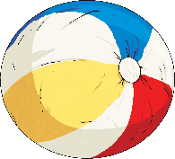
Menu
Week 1 Friday
Place Value
Fractions
Reveal answer
Reveal answer
Which symbol completes this number sentence?
Subtract these fractions:
5
-
1
=
3
>
8
4
8
10 101
10 011
Problem Solving
Reveal answer
The area of the face of a cube is 16cm². What is the volume of the cube?
+ and −
Reveal answer
=
64 cm³
309 200 + 70 000 = 379 200
Reveal answer
92 410 - 30 000 =
62 410
Reasoning
If I count on a number line from −8 to 13, the difference will be 21.
× and ÷
Reveal answer
Use a written method to solve this calculation:
52 × 29 = 1508
Is Jamil correct? Explain your reasoning.

