Slide 1
Y4/5 – Summer Block 4 – Shape – Step – 1
About This Resource:
This PowerPoint has been designed to support your teaching of this small step from the Mixed Age planning. It includes a starter activity suitable for each year group and an example of each question from the Varied Fluency and Reasoning and Problem Solving resources also provided in this pack (separate for each year group). Each slide has the year group identified in the bottom right-hand corner. We recommend that you look through this PowerPoint in advance and decide whether to work through all examples provided or a selection of them depending on the needs of your class.
National Curriculum Objectives:
Mathematics Year 4: (4G4) Identify acute and obtuse angles and compare and order angles up to two right angles by size
Mathematics Year 5: (5G4a) Know angles are measured in degrees: estimate and compare acute, obtuse and reflex angles
Mathematics Year 5: (5G4b) Identify angles at a point and one whole turn (total 360)
Mathematics Year 5: (5G4b) Identify angles at a point on a straight line and 1/2 a turn (total 180)
Mathematics Year 5: (5G4b) Identify other multiples of 90
Mathematics Year 5: (5G4c) Draw given angles, and measure them in degrees
More Year 4 and Year 5 Shape resources.
Did you like this resource? Don’t forget to review it on our website.
© Classroom Secrets Limited 2019

Slide 2
Y4/5 – Summer Block 4 – Shape
Step 1
Year 4: Identify Angles
Year 5: Measuring Angles in Degrees
© Classroom Secrets Limited 2019

Slide 3
Introduction
Sort the angles.
Smaller than a right angle (acute) | Right angle | Larger than a right angle (obtuse)
Y4
© Classroom Secrets Limited 2019

Slide 4
Introduction
Sort the angles.
Smaller than a right angle (acute) | Right angle | Larger than a right angle (obtuse)
Y4
© Classroom Secrets Limited 2019

Slide 5
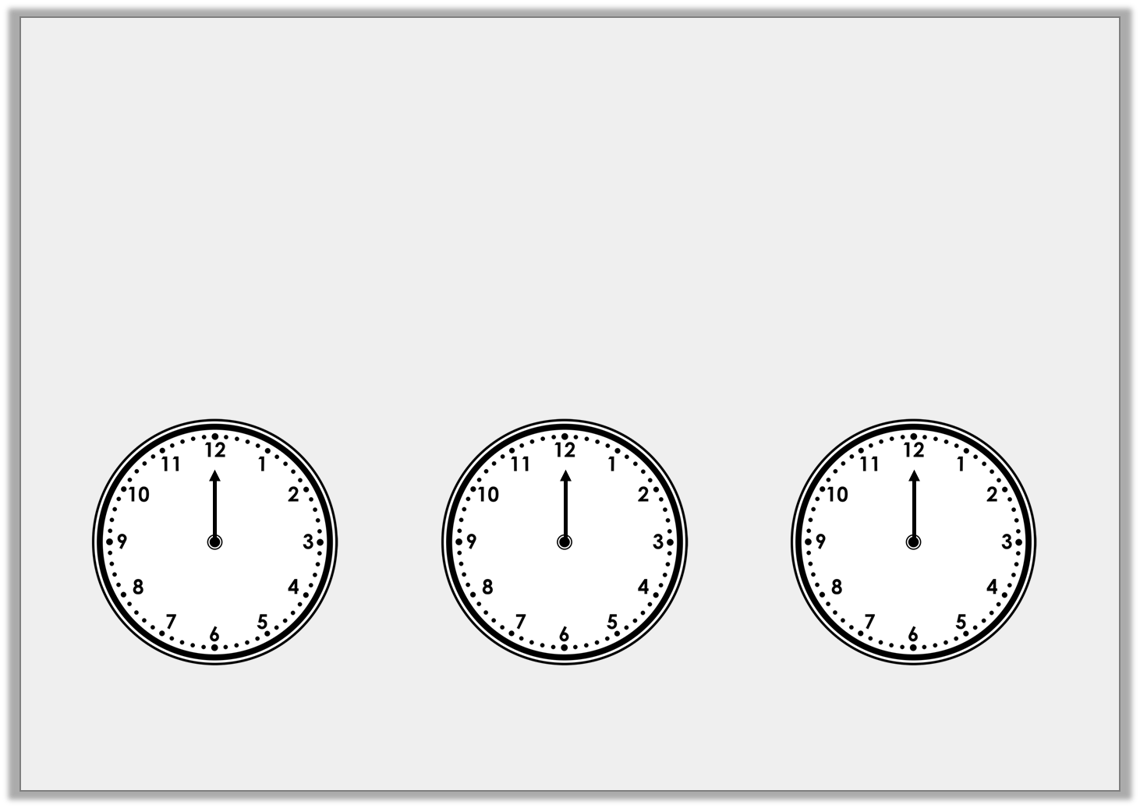
Introduction
The hour hand is stuck on 12.
Draw the minute hand on the clock so the time shown makes an acute angle:
Draw the minute hand on the clock so the time shown makes a right angle:
Draw the minute hand on the clock so the time shown makes an obtuse angle:
Y5
© Classroom Secrets Limited 2019

Slide 6
Introduction
The hour hand is stuck on 12.
Draw the minute hand on the clock so the time shown makes an acute angle:
Draw the minute hand on the clock so the time shown makes a right angle:
Draw the minute hand on the clock so the time shown makes an obtuse angle:
Any time between 12:16 – 12:29 and 12:31 – 12:44
Any time between 12:46 and 12:14
Either 12:15 or 12:45
Y5
© Classroom Secrets Limited 2019

Slide 7
Varied Fluency 1
Circle all the obtuse angles.
Y4
© Classroom Secrets Limited 2019

Slide 8
Varied Fluency 1
Circle all the obtuse angles.
Y4
© Classroom Secrets Limited 2019

Slide 9
Varied Fluency 2
Use the symbols < or > to make the statements correct.
obtuse angle
90°
Y4
© Classroom Secrets Limited 2019

Slide 10
Varied Fluency 2
Use the symbols < or > to make the statements correct.
>
obtuse angle
90°
Y4
© Classroom Secrets Limited 2019

Slide 11
Varied Fluency 3
Match the angle size to the correct label.
acute angle
obtuse angle
Y4
© Classroom Secrets Limited 2019

Slide 12
Varied Fluency 3
Match the angle size to the correct label.
acute angle
obtuse angle
Y4
© Classroom Secrets Limited 2019

Slide 13
Varied Fluency 4
Use the line to draw an acute angle.
Y4
© Classroom Secrets Limited 2019

Slide 14
Varied Fluency 4
Use the line to draw an acute angle.
Y4
© Classroom Secrets Limited 2019

Slide 15
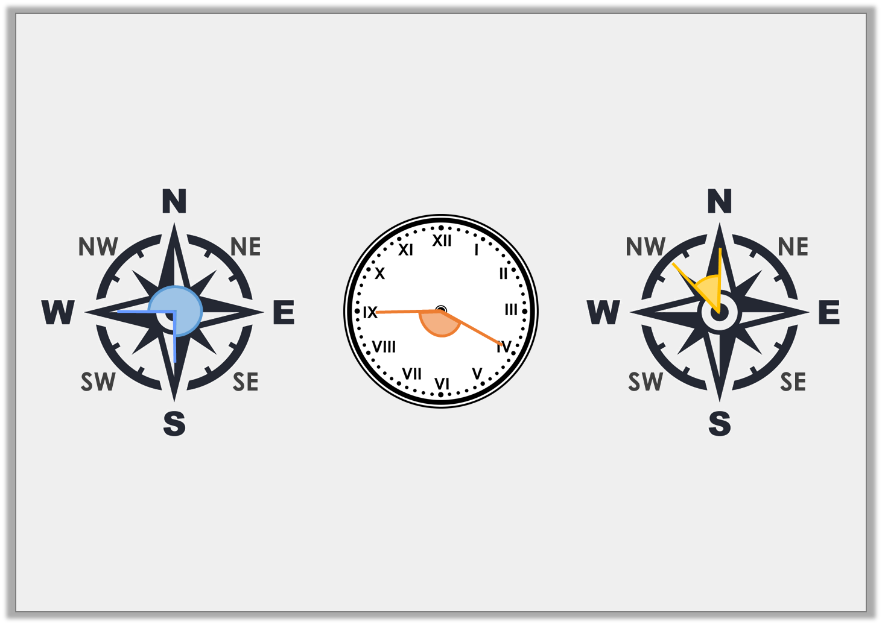
Varied Fluency 1
Label each image with the name of the angle.
A.
B.
C.
Y5
© Classroom Secrets Limited 2019

Slide 16
Varied Fluency 1
Label each image with the name of the angle.
A.
B.
C.
Reflex angle
Obtuse angle
Acute angle
Y5
© Classroom Secrets Limited 2019

Slide 17
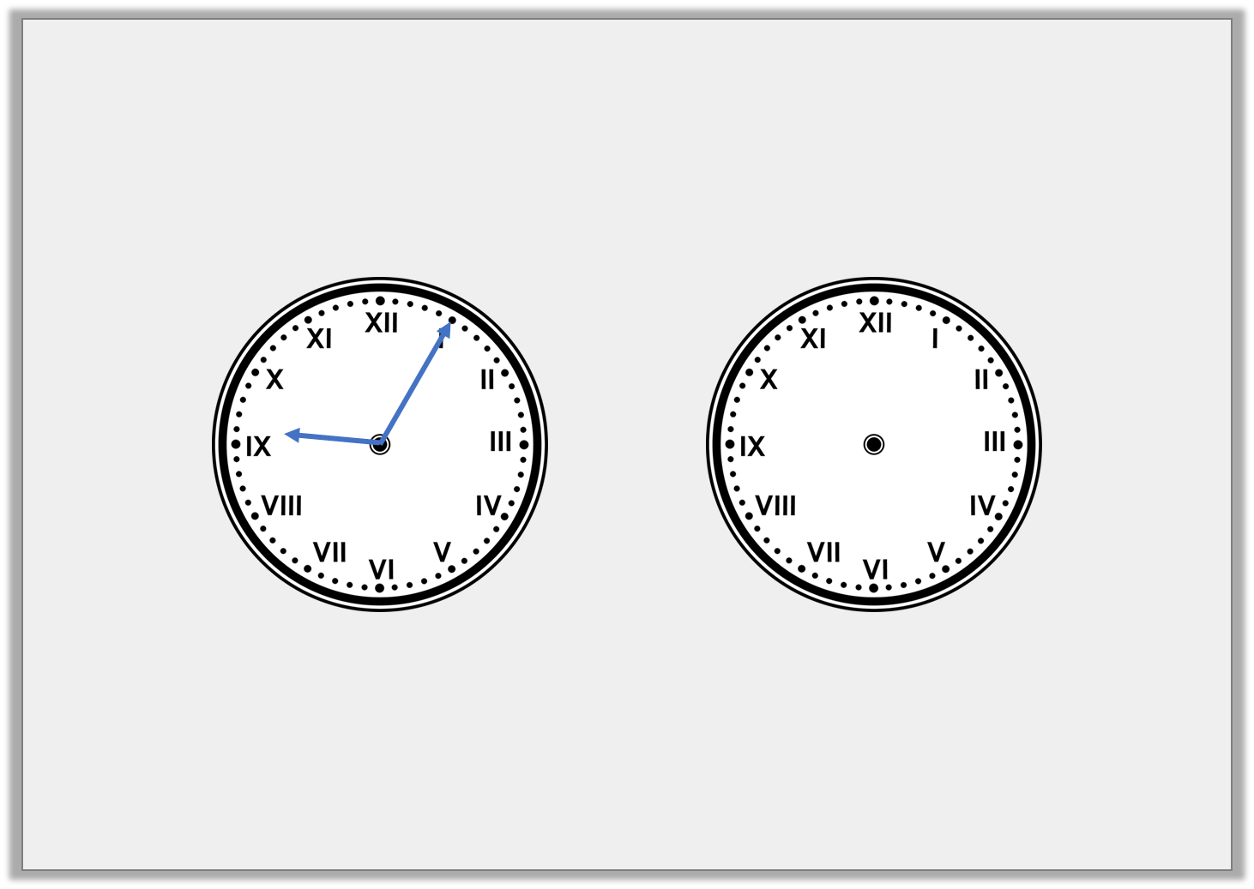
Varied Fluency 2
Look at the time on the clock. Draw where the minute hand will be after a 180° turn clockwise.
Y5
© Classroom Secrets Limited 2019

Slide 18
Varied Fluency 2
Look at the time on the clock. Draw where the minute hand will be after a 180° turn clockwise.
Y5
© Classroom Secrets Limited 2019

Slide 19
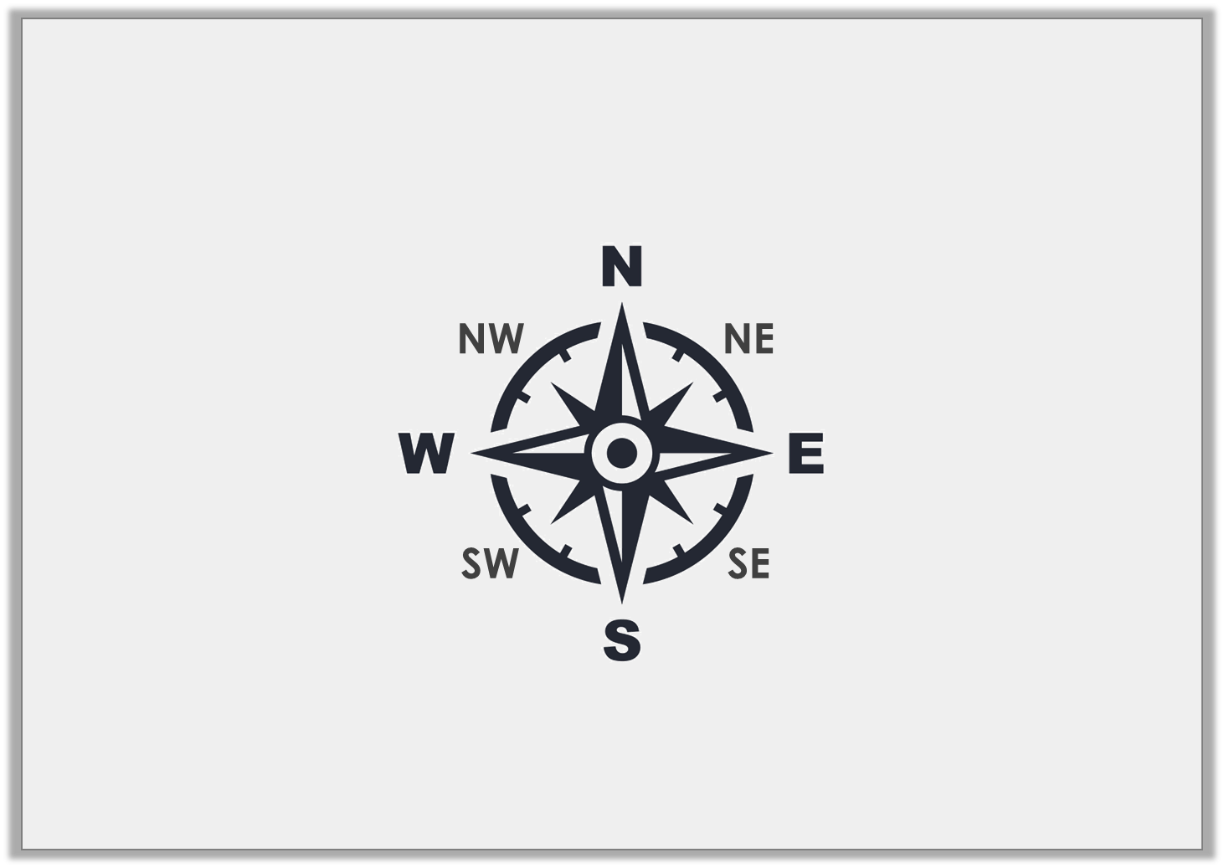
Varied Fluency 3
How many degrees will I move through if I turn from SE to N anti-clockwise?
Y5
© Classroom Secrets Limited 2019

Slide 20
Varied Fluency 3
How many degrees will I move through if I turn from SE to N anti-clockwise?
135°
Y5
© Classroom Secrets Limited 2019

Slide 21
Varied Fluency 4
How many turns are equal to 270°?
1
8
Y5
© Classroom Secrets Limited 2019

Slide 22
Varied Fluency 4
How many turns are equal to 270°?
6 turns
1
8
1
6
2
5
3
4
Y5
© Classroom Secrets Limited 2019

Slide 23
Varied Fluency 4
Use >, < or = to complete the equation.
3
4
360° |  | turn
Y5
© Classroom Secrets Limited 2019

Slide 24
Varied Fluency 4
Use >, < or = to complete the equation.
3
4
360° | > | turn
Y5
© Classroom Secrets Limited 2019

Slide 25
Problem Solving 1
Match the angles which will still be acute
when they are combined.
10°
12°
20°
79°
60°
65°
Y4
© Classroom Secrets Limited 2019

Slide 26
Problem Solving 1
Match the angles which will still be acute
when they are combined.
10°
12°
20°
79°
60°
65°
Y4
© Classroom Secrets Limited 2019

Slide 27
Reasoning 1
Which angle is the odd one out?
Explain your answer.
Y4
© Classroom Secrets Limited 2019

Slide 28
Reasoning 1
Which angle is the odd one out?
Explain your answer.
This angle is acute while all the others are right angles.
Y4
© Classroom Secrets Limited 2019

Slide 29
Problem Solving 2
Using the digits below, can you create
more obtuse or acute angles?
6
1
0
8
Y4
© Classroom Secrets Limited 2019

Slide 30
Problem Solving 2
Using the digits below, can you create
more obtuse or acute angles?
2-digit acute possibilities:
61°, 60°, 68°, 16°, 10°, 18°, 86°, 81°, 80°
3-digit obtuse possibilities:
108°, 106°, 160°, 168°
There are more acute than obtuse angles possible.
6
1
0
8
Y4
© Classroom Secrets Limited 2019

Slide 31
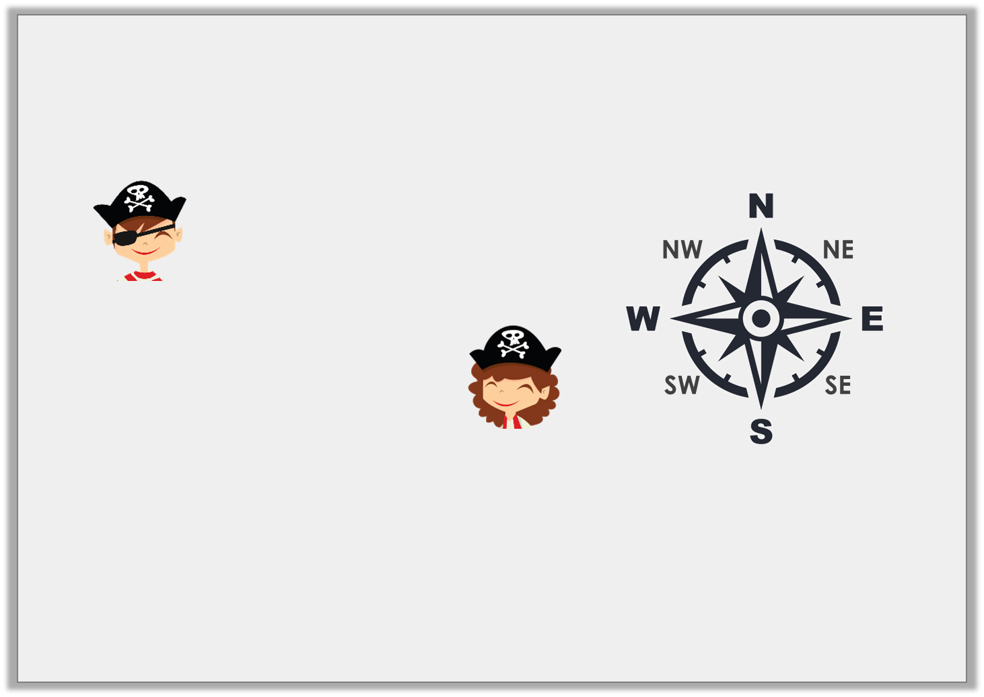
Reasoning 1
These pirates are facing south east and their captain has told them that they need to turn to face north east.
Who do you agree with? Explain.
We need to turn through
a reflex angle.
Henry
We need to make a turn anti-clockwise.
1
4
Olga
Y5
© Classroom Secrets Limited 2019

Slide 32
Reasoning 1
These pirates are facing south east and their captain has told them that they need to turn to face north east.
Who do you agree with? Explain.
They are both correct because…
We need to turn through
a reflex angle.
Henry
We need to make a turn anti-clockwise.
1
4
Olga
Y5
© Classroom Secrets Limited 2019

Slide 33
Reasoning 1
These pirates are facing south east and their captain has told them that they need to turn to face north east.
Who do you agree with? Explain.
They are both correct because a reflex angle of 270° clockwise will reach NE and a (90°) turn anti-clockwise will also reach NE.
We need to turn through
a reflex angle.
Henry
We need to make a turn anti-clockwise.
1
4
Olga
1
4
Y5
© Classroom Secrets Limited 2019

Slide 34
Problem Solving 1
Which of the following cards could be
used to complete the statement?
Give all of the possible answers.
N
NE
E
SE
S
SW
W
NW
A 270° turn | > | turning from NW to ______ anti-clockwise | > | a 90° turn
Y5
© Classroom Secrets Limited 2019

Slide 35
Problem Solving 1
Which of the following cards could be
used to complete the statement?
Give all of the possible answers.
S, SE and E.
N
NE
E
SE
S
SW
W
NW
A 270° turn | > | turning from NW to ______ anti-clockwise | > | a 90° turn
Y5
© Classroom Secrets Limited 2019

Slide 36
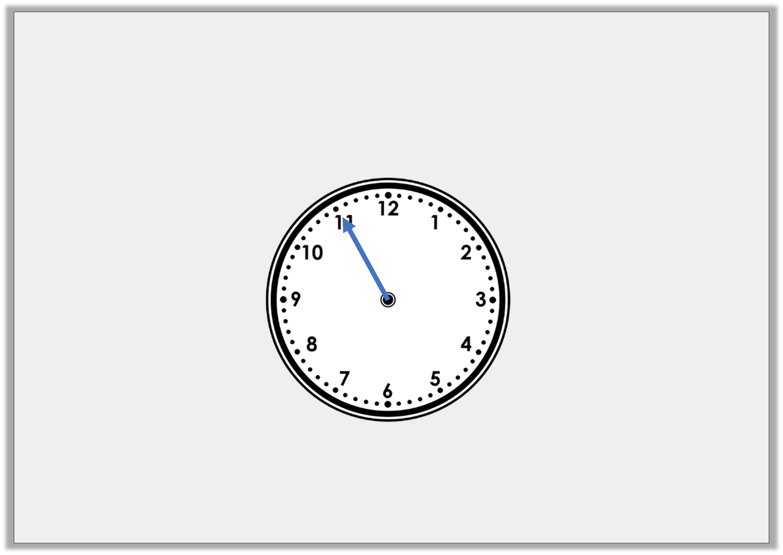
Problem Solving 2
Starting at 06:55, the minute hand makes more than 4 but
fewer than 7 quarter turns clockwise.
What times could the clock show after the turns?
Y5
© Classroom Secrets Limited 2019

Slide 37
Problem Solving 2
Starting at 06:55, the minute hand makes more than 4 but
fewer than 7 quarter turns clockwise.
What times could the clock show after the turns?
5 quarter turns clockwise – 08:10
6 quarter turns clockwise – 08:25
Y5
© Classroom Secrets Limited 2019

