Slide 1
Monday
Can you use your grown up letter names by spotting and saying the letters?
Can you sing the alphabet?

Slide 2
Tuesday
Syllables in Words
Words can be broken down into syllables to help children to spell them. Syllables are like the beats in a word. We learn to clap the syllables in words. Try saying these words aloud and clapping them with your family:
Frog – 1 clap
Bat – 1 clap
Hamster – 2 claps
Turtle – 2 claps
Please see the next page to continue with Tuesday’s lesson.

Slide 3
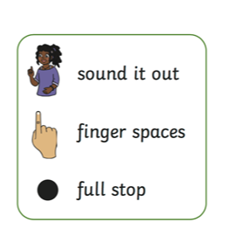
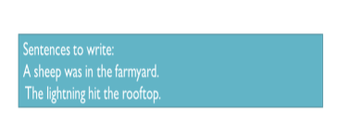
Tuesday
Can you write a sentence using two syllable words?
Remember: you can plan your sentence first by laying it out with objects. Can you start with a capital letter, put finger spaces between your words and finish with a full stop? Don’t forget to break down those two syllable words!

Slide 4
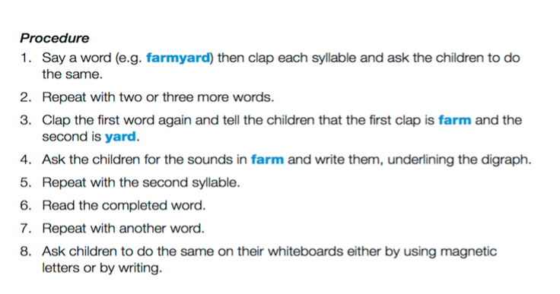
Wednesday

Slide 5
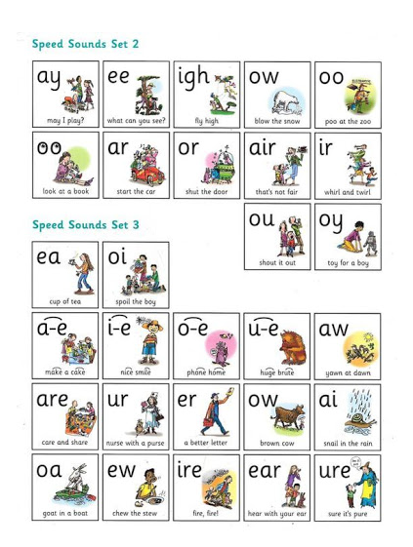
Thursday
Thursday
How many of these sounds do you recognise? Can you say them and their rhyme? Can you
write the sounds you know?

Slide 6
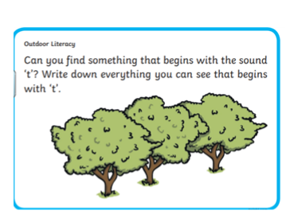
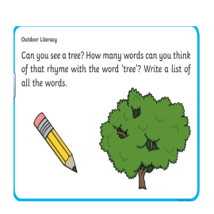
Friday

