Slide 2
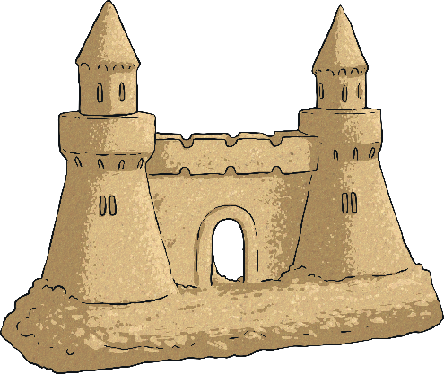
Monday
Tuesday
Wednesday
Thursday
Friday

Slide 3
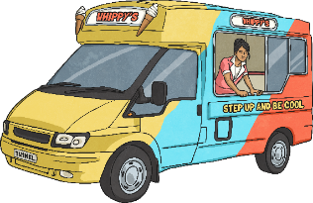
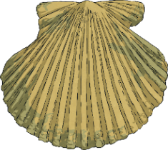
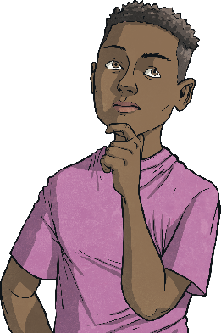
Menu
Summer 5 Monday
Place Value
Fractions
Reveal answer
Reveal answer
Write eight hundred and thirty-six thousand, five hundred and twelve in numerals.
What number is hidden in these equivalent fractions?
1
=
4
6
24
836 512
Problem Solving
Reveal answer
Write three square numbers between 20 and 50.
+ and −
Reveal answer
25
36
49
16 300 + 900 = 17 200
Reveal answer
30 100 - 400 =
29 700
Reasoning
I can multiply a number by 1 or divide a number by 1 and the answer will be the same.
× and ÷
Reveal answer
Use a written method to solve this calculation:
9216 × 5 = 46 080
Is Jamil correct?
Explain your reasoning.

Slide 4
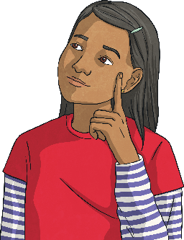
Menu
Summer 5 Tuesday
Place Value
Fractions
Reveal answer
Reveal answer
What is this number? DCCXXVIII
What number is hidden in these equivalent fractions?
3
=
12
4
16
728
Problem Solving
Reveal answer
What 3D shape will be formed by this net?
+ and −
Reveal answer
A triangular prism
 |  | 1 | 1 | 7 | 4 | 1
 | + | 8 | 8 | 4 | 2 | 0
1 | 0 | 0 | 1 | 6 | 1
Reasoning
1
1
If I count in tenths, one number that I say will be twelve tenths or one and two tenths.
× and ÷
Reveal answer
Use a written method to solve this calculation:
4896 ÷ 6 = 816
Is Saniya correct?
Explain your reasoning.

Slide 5
Menu
Summer 5 Wednesday
Place Value
Fractions
Reveal answer
Reveal answer
Round 472 652 to the nearest ten thousand.
Convert this mixed number into an improper fraction:
1
7
=
17
10
10
470 000
Problem Solving
Reveal answer
Complete this calculation:
+ and −
Reveal answer
0.02 × 5 = 0.01 + 0.09
48 030 + 6000 = 54 030
Reveal answer
30 100 - 300 =
29 800
Reasoning
If £780 is shared among 1000 people, each person will receive £7.80.
× and ÷
Reveal answer
Use a written method to solve this calculation:
9322 × 8 = 74 576
Is Jamil correct?
Explain your reasoning.

Slide 6
Menu
Summer 5 Thursday
Place Value
Fractions
Reveal answer
Reveal answer
Count forwards in steps of 1000 from 8020. What are the first three numbers?
Use the greater than or less than symbols to compare these fractions:
2
>
7
3
12
9020
10 020
11 020
Problem Solving
Reveal answer
Which two words could be used to describe these lines?
+ and −
acute
Reveal answer
obtuse
vertical
horizontal
horizontal
 |  | 8 | 0 | 5 | 0 | 3
 | - | 3 | 6 | 9 | 8 | 3
parallel
parallel
perpendicular
 | 4 | 3 | 5 | 2 | 0
Reasoning
This teaspoon measures 5ml or 0.05l.
× and ÷
Reveal answer
Use a written method to solve this calculation:
1407 ÷ 3 = 469
Is Saniya correct?
Explain your reasoning.

Slide 7
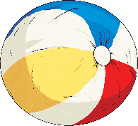
Menu
Summer 5 Friday
Place Value
Fractions
Reveal answer
Reveal answer
Which symbol completes this number sentence?
Subtract these fractions:
3
-
5
=
4
1
>
4
12
12
or
3
52 252
52 225
Problem Solving
Reveal answer
A school raise £7635 for a local charity. A newspaper recorded that the school had raised £8000. What had the newspaper done?
+ and −
Reveal answer
190 400 + 17 000 = 207 400
Rounded to the nearest £1000.
Reveal answer
153 020 - 60 020 =
93 000
Reasoning
In my class, 40% of the children are boys, so are girls.
× and ÷
Reveal answer
3
Use a written method to solve this calculation:
5
32 × 29 = 928
Is Jamil correct?
Explain your reasoning.

