Slide 2
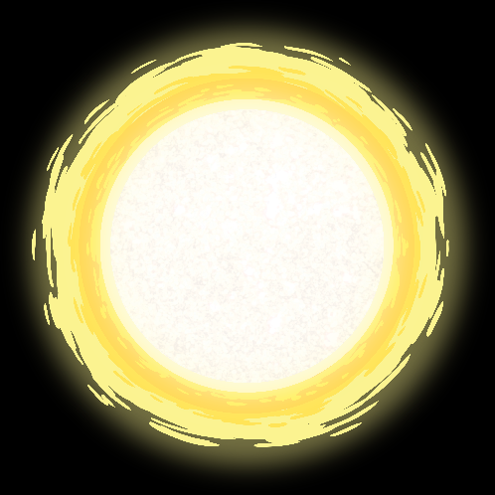
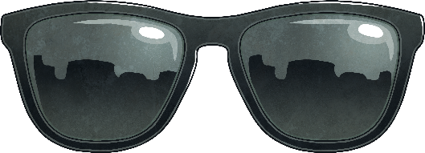
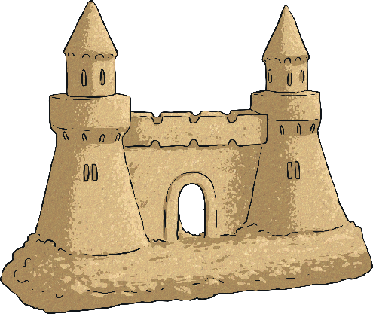
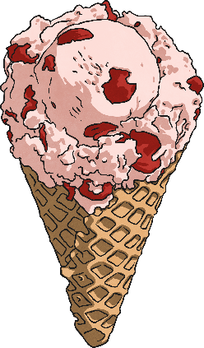
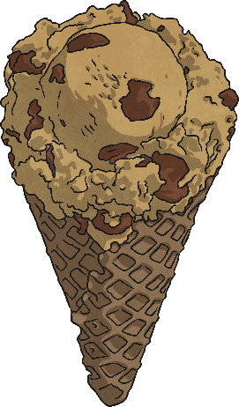
Monday
Tuesday
Wednesday
Thursday
Friday

Slide 3
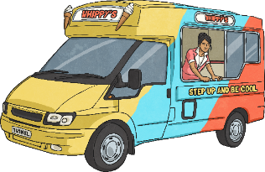
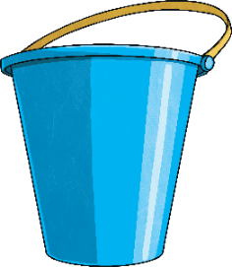
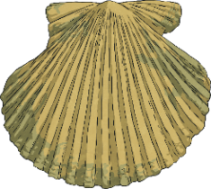
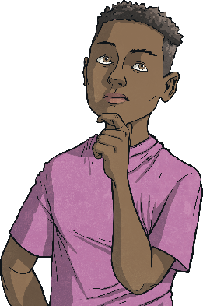
Menu
Summer 8 Monday
Place Value
Fractions
Reveal answer
Reveal answer
Write four hundred and twenty-two thousand, nine hundred and twelve in numerals.
What number is hidden in these equivalent fractions?
4
=
16
5
20
422 912
Problem Solving
Reveal answer
Write three numbers that have factor pairs of 5 and 8:
+ and −
120
Reveal answer
40
80
45 200 + 800 = 46 000
Reveal answer
(or any multiple of 40)
45 000 - 1400 =
43 600
Reasoning
When I multiply a number by 1, the answer is always 1.
× and ÷
Reveal answer
Use a written method to solve this calculation:
6860 × 3 = 20 580
Is Jamil correct? Explain your reasoning.

Slide 4
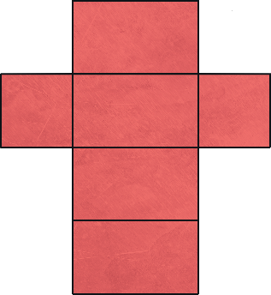
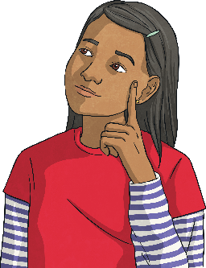
Menu
Summer 8 Tuesday
Place Value
Fractions
Reveal answer
Reveal answer
What is this number? CCCV
What number is hidden in these equivalent fractions?
1
=
2
8
16
305
Problem Solving
Reveal answer
What 3D shape will be formed by this net?
+ and −
Reveal answer
A cuboid
 | 3 | 1 | 8 | 3 | 7
+ | 8 | 8 | 2 | 5 | 3
1 | 2 | 0 | 0 | 9 | 0
 | 1 | 1 |  | 1
Reasoning
If I count on from -1 in steps of 4 I will say the number zero.
× and ÷
Reveal answer
Use a written method to solve this calculation:
1784 ÷ 4 = 446
Is Saniya correct? Explain your reasoning.

Slide 5
Menu
Summer 8 Wednesday
Place Value
Fractions
Reveal answer
Reveal answer
Round 7.95 to the nearest tenth.
Convert this mixed number into an improper fraction:
3
3
=
27
8
8
8
Problem Solving
Reveal answer
Complete this calculation:
+ and −
Reveal answer
34 ÷ 100 = 1 - 0.66
24 350 + 7000 = 31 350
Reveal answer
40 000 - 2300 =
37 700
Reasoning
An obtuse angle is always greater than an acute angle.
× and ÷
Reveal answer
Use a written method to solve this calculation:
8718 × 4 = 34 872
Is Jamil correct? Explain your reasoning.

Slide 6
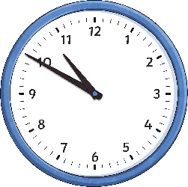
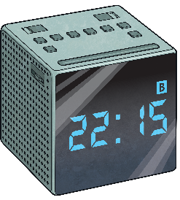
Menu
Summer 8 Thursday
Place Value
Fractions
Reveal answer
Reveal answer
Count backwards in steps of 100 from 5209. What are the first three numbers?
Use the greater than or less than symbols to compare these fractions:
3
<
7
5
10
5109
5009
4909
Problem Solving
Reveal answer
The area of this rectangle is 36cm² and the perimeter is 26cm. What is the length of each side?
+ and −
Reveal answer
4 cm
 | 9 | 8 | 0 | 3 | 3
- | 8 | 6 | 1 | 5 | 3
9 cm
 | 1 | 1 | 8 | 8 | 0
Reasoning
These clocks could be showing times 25 minutes apart.
× and ÷
Reveal answer
Use a written method to solve this calculation:
8883 ÷ 9 = 987
Is Saniya correct? Explain your reasoning.

Slide 7
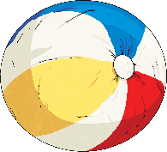
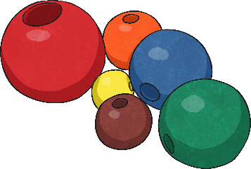
Menu
Summer 8 Friday
Place Value
Fractions
Reveal answer
Reveal answer
Which symbol completes this number sentence?
Add these fractions:
1
+
1
=
3
>
4
8
8
46 464
46 446
Problem Solving
Reveal answer
1
of a set of beads are blue and 50% are red. The rest are yellow. What fraction of the beads are yellow?
3
+ and −
Reveal answer
1
130 400 + 18 000 = 148 400
6
Reveal answer
153 900 - 60 000 =
93 900
Reasoning
I have 3 boxes of tennis balls, which contain 12 tennis balls altogether. If I had 5 boxes, I would have 16 tennis balls.
× and ÷
Reveal answer
Use a written method to solve this calculation:
43 × 29 = 1247
Is Jamil correct? Explain your reasoning.

