Slide 1
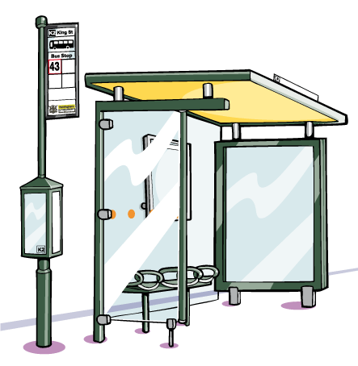
Division- the bus stop method

Slide 2
159 ÷ 3
=53
0
5
3
3
1
1
5
9
1÷3=0 remainder 1
15÷3=5
9÷3=3

Slide 3
285 ÷ 5
=57
0
5
7
2
3
5
2
8
5
2÷5=0 r 2
35÷5=7
28÷5=5 r 3

Slide 4
288 ÷ 12
=24
0
2
4
2
4
12
2
8
8
48÷12=4
2÷12=0 r 2
28÷12=2 r 4

Slide 5
5.44 ÷ 4
=1.36
1
3
6
.
1
2
4
5
4
4
.
14÷4=3 r 2
5÷4=1 r 1
24÷4=6

Slide 6
27 ÷ 5
=5.4
0
5
4
.
2
2
5
2
7
0
.
20÷5=4
2÷5=0 r 2
27÷5=2 r 2

Slide 7
34 ÷ 8
=4.25
0
4
2
5
.
2
4
3
0
8
3
4
0
.
3÷8=0 r 3
34÷8=4 r 2
20÷8=2 r 4
40÷8=5

