Slide 1


Slide 3


Are the groups equal or not equal?
2) Are the groups equal or not equal?
3) Are the groups equal or not equal?

Slide 4
Are the groups equal or not equal?
2) Are the groups equal or not equal?
3) Are the groups equal or not equal?
equal
not equal
equal

Slide 6





Ron is sharing out the strawberries.
How many strawberries will each child get?
12
There are ____ strawberries.
There are ____ children.
Each child will get ____ strawberries.
3
4

Slide 7

Ron is sharing out the strawberries.
How many strawberries will each child get?
12
There are ____ strawberries.
There are ____ children.
Each child will get ____ strawberries.
4
3

Slide 8

12
There are ____ strawberries.
There are ____ children.
Each child will get ____ strawberries.
There are ____ strawberries left over.
5
2
2

Slide 9

Did someone mention left over strawberries?

Slide 10





Whitney has 16 flowers.
Have a think
She shares them equally between some vases.
How many different ways could Whitney share her flowers to make equal groups?

Slide 11
2 vases with 8 flowers in each vase.

Slide 12
16 didn’t share into 3 equal groups.

Slide 13
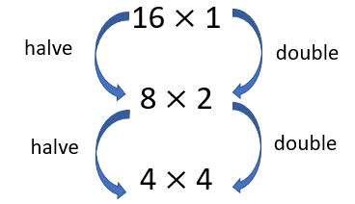
2 vases with 8 flowers in each vase.
4 vases with 4 flowers in each vase.
8 vases with 2 flowers in each vase.
16 vases with 1 flower in each vase.

Slide 14
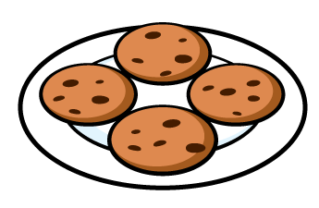
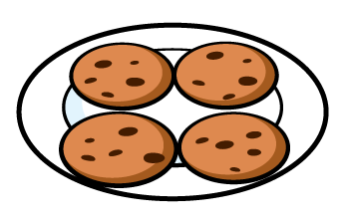


How can we represent this as a written calculation?
$$÷$$
8
2
$$=$$
4

Slide 15


How can we represent this as a written calculation?
20
$$÷$$
5
$$=$$
4

Slide 16
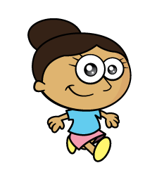




Which division calculation matches the problem below?
Dora has 6 plates.
She shares 18 cookies equally onto the plates.
$$=$$
$$÷$$
$$=$$
$$÷$$
18
6
6
18

Slide 17
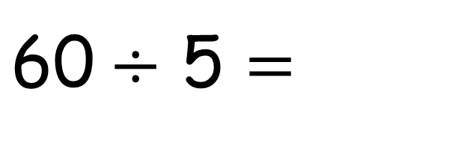
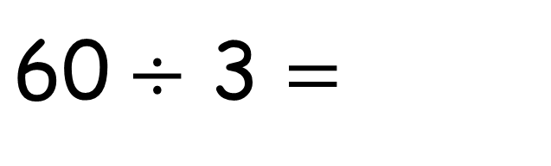
$\text{60}÷$ 3 $=$
20
$\text{60}÷$ 5 $=$
12

