Slide 1
ART
Wednesday 20th January

Slide 2
Andy warhol
Andy Warhol was born in Pennsylvania, USA. He was an American Artist who began producing work in a ‘Pop Art style’ in the 20th century.
He created screen-prints using photo quality images and changed them using bright colours.
He was famous for exploring popular culture in his work. This is anything from Coca Cola bottles to pop stars to the clothes people like to wear.

Slide 3
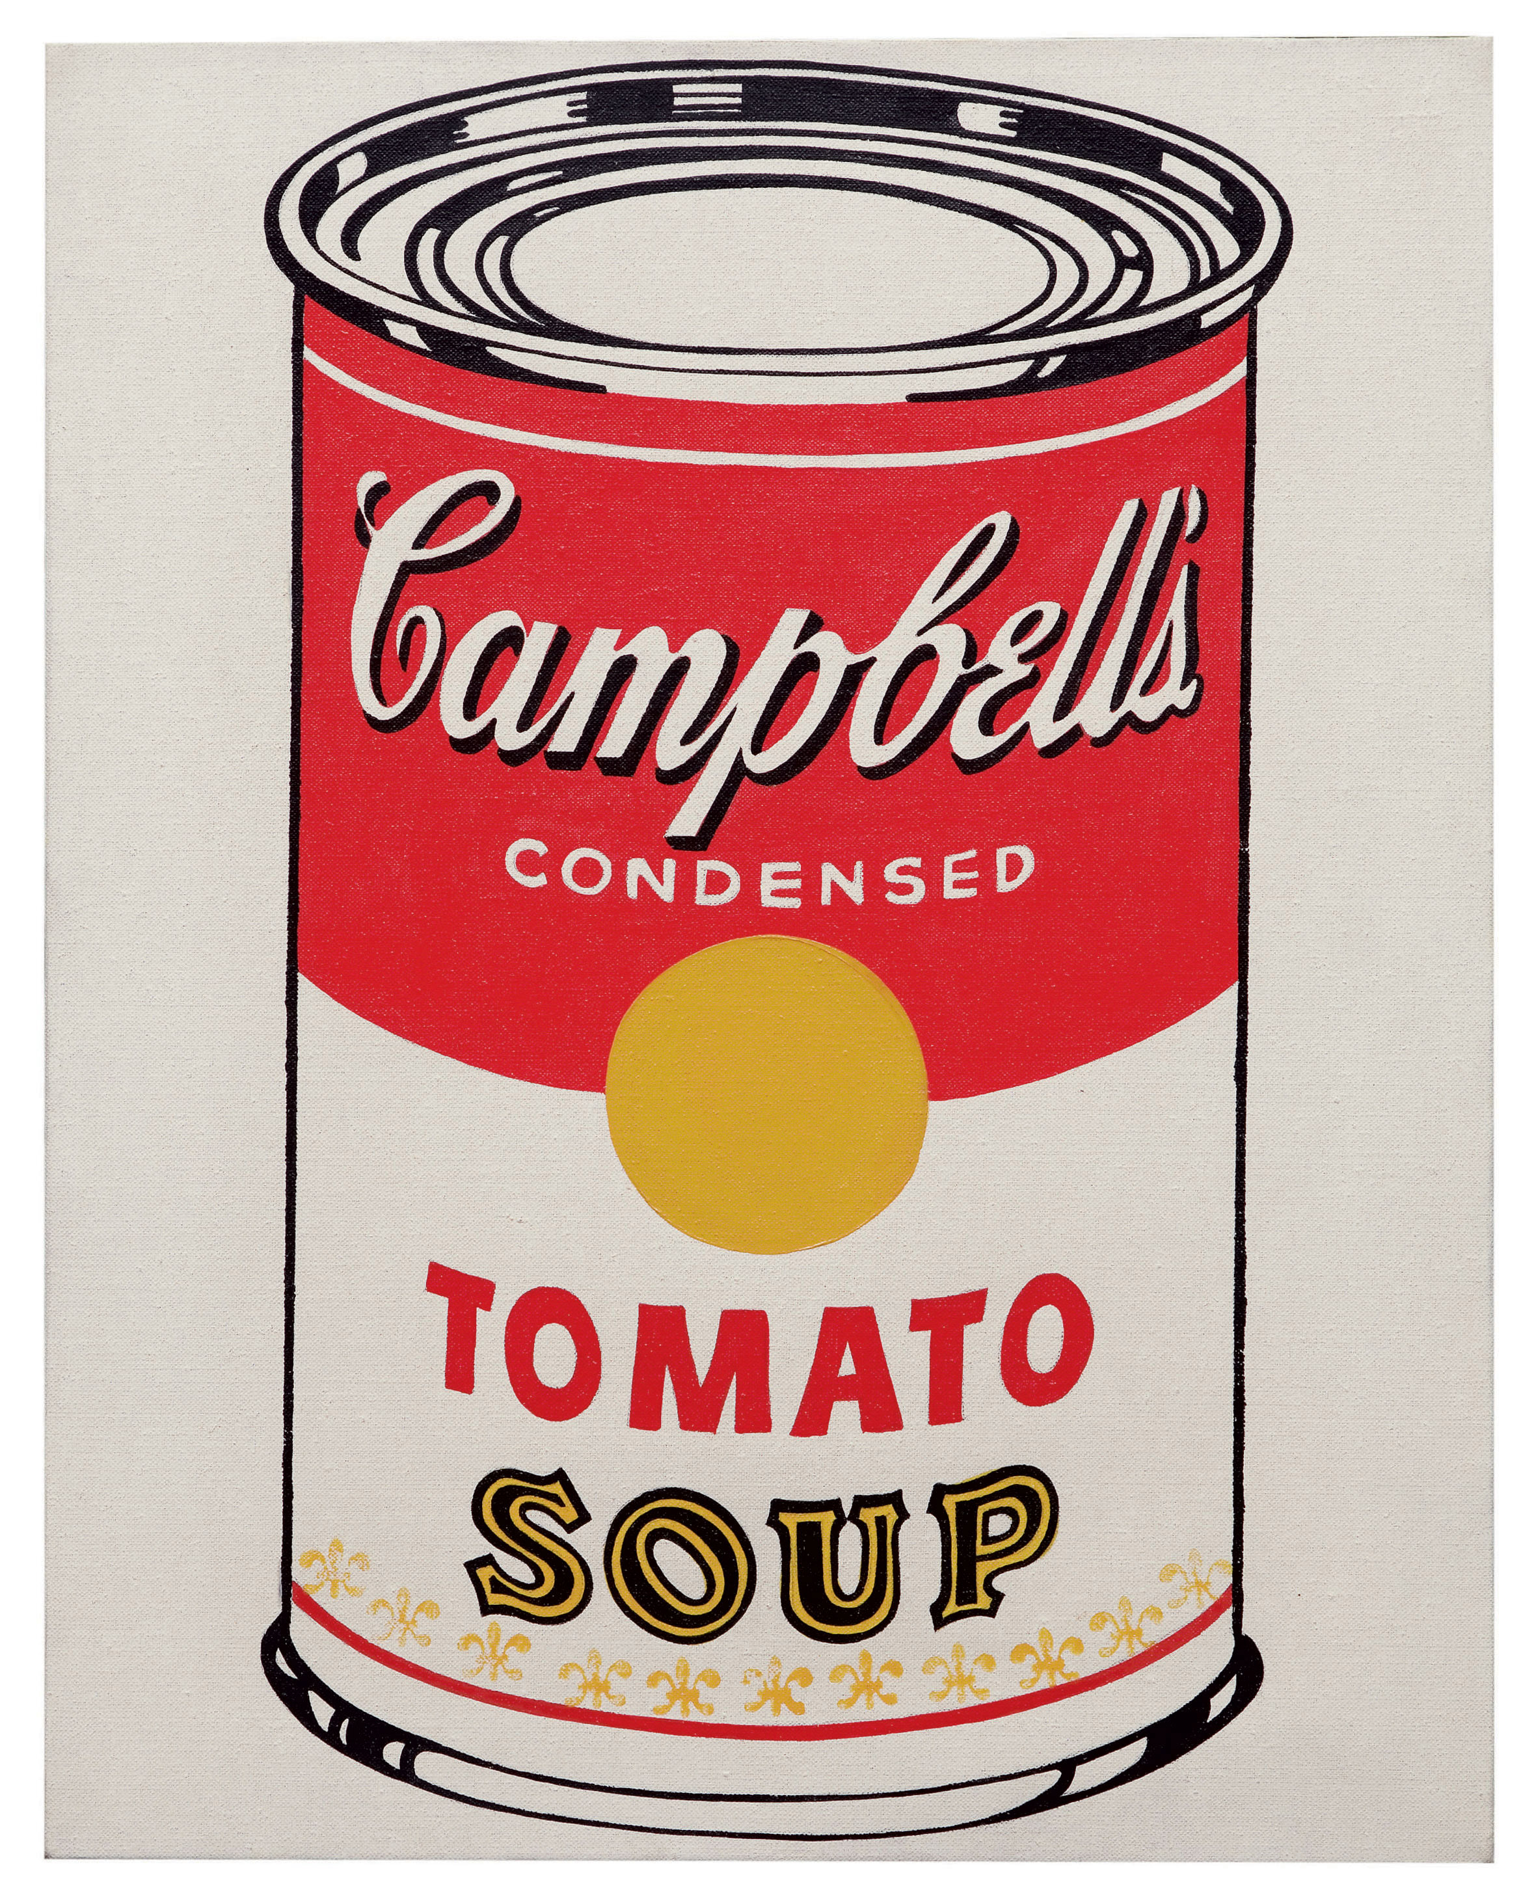
Campbell’s soup
He made a print of Campbell’s Soup – a popular brand of soup in the USA. He said he ate Campbell’s tomato soup everyday for lunch for 20 years!

Slide 4
Andy Warhol’s style
Warhol was famous for exploring everyday and familiar objects in his work. He would often repeat images in grid formations.
He liked the idea of taking ordinary things like cereal or bananas, and turning them into art.
It was often bold and colourful.
He didn’t always stick exactly in the lines.
Have a look is some of his work

Slide 5
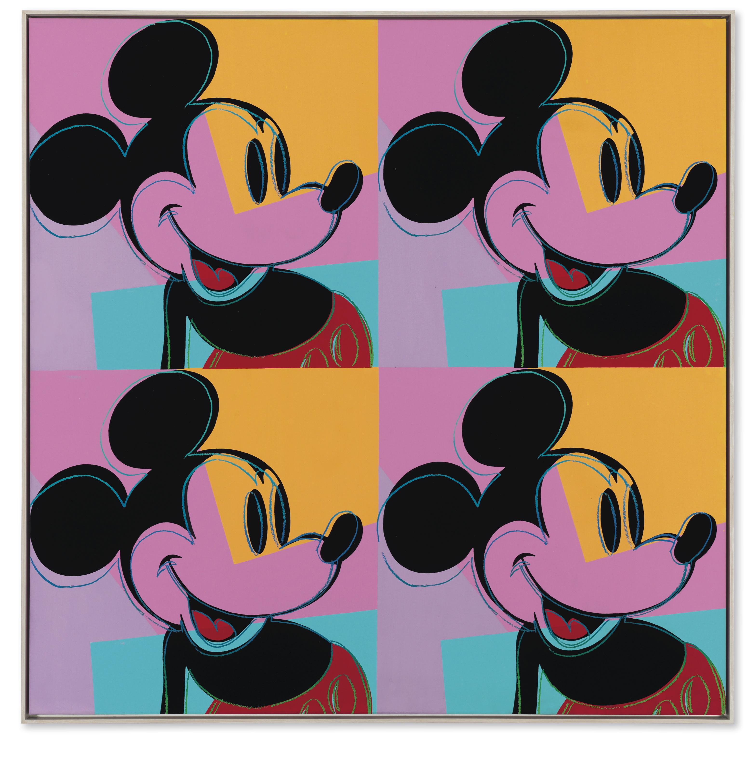
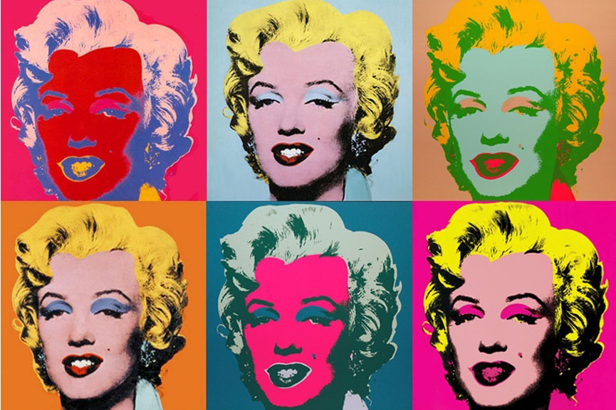
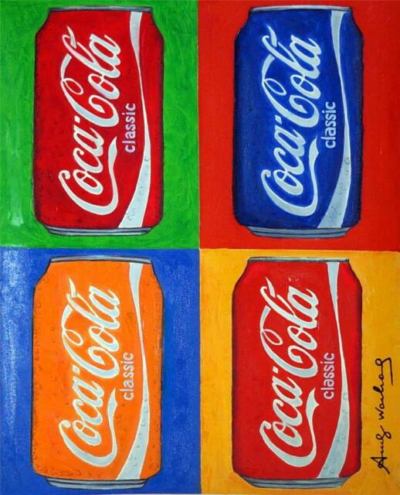
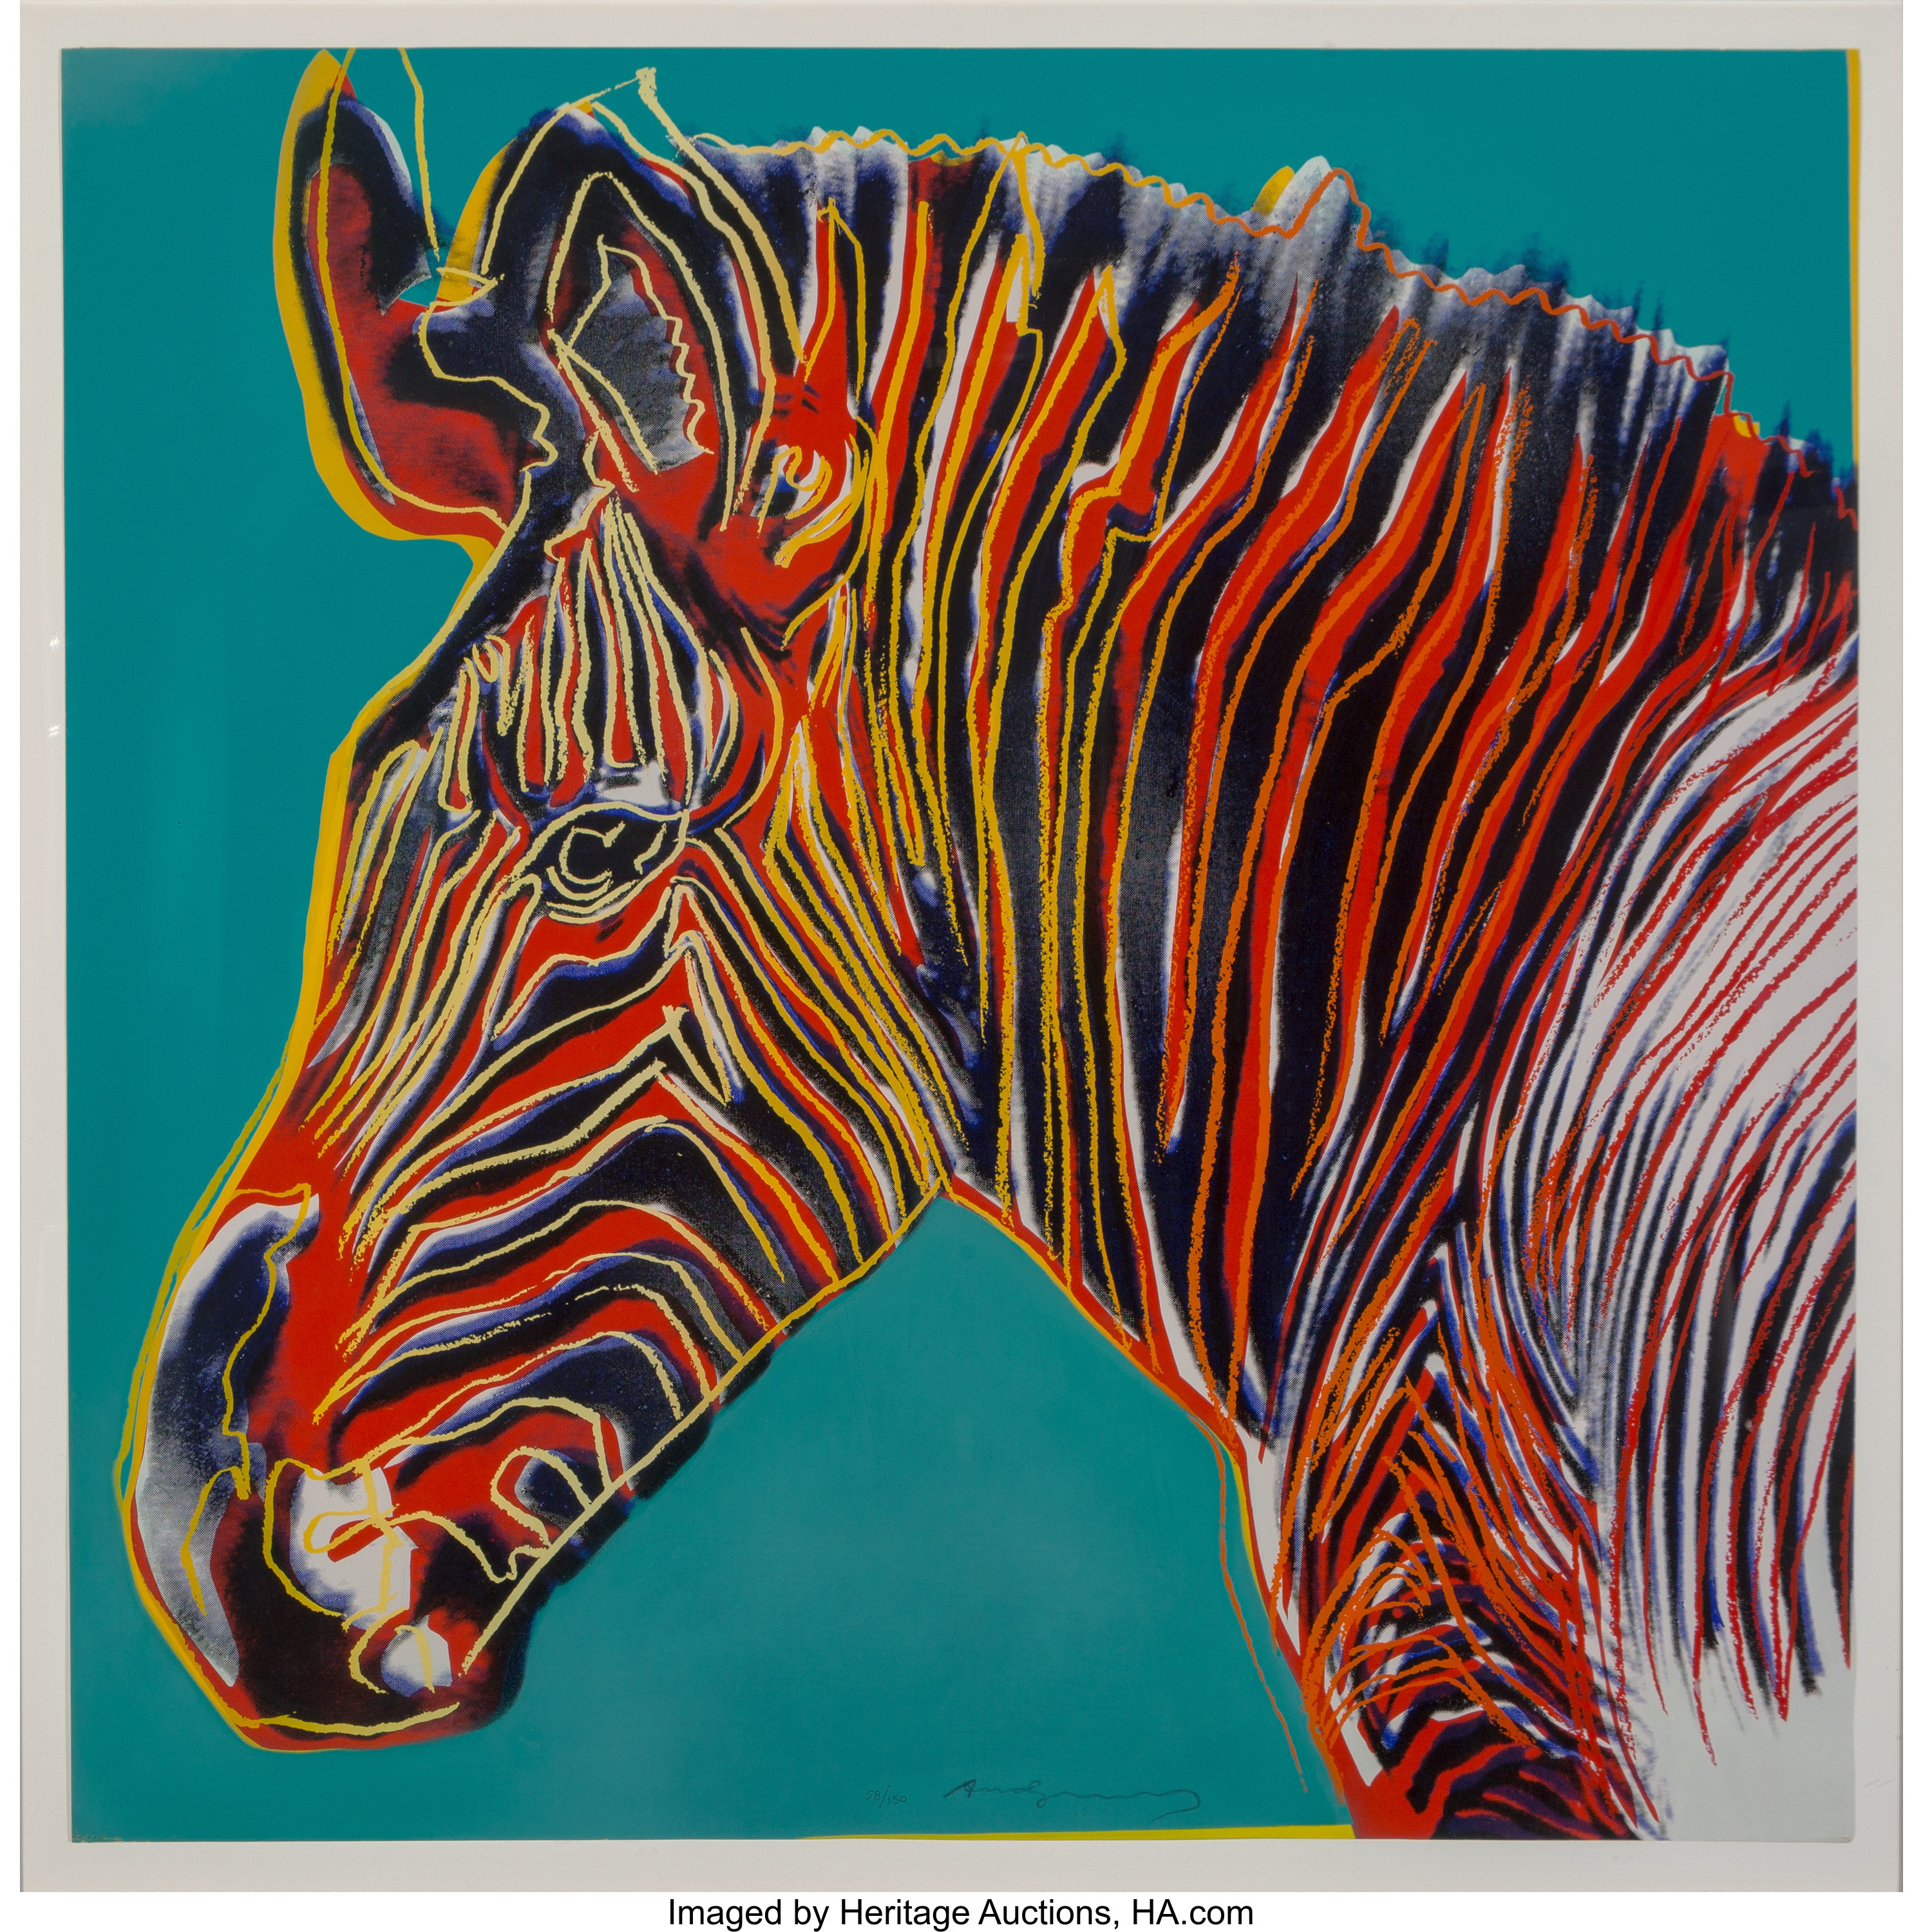
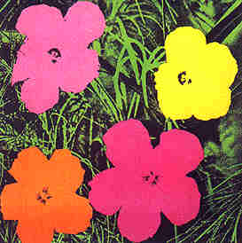

Slide 6
What inspired him?
Warhol was very ill as a child, so he spent lots of time in bed. To cheer himself up he read comics and magazines about his favourite characters and movie stars.
One of his most famous screenprints is of the Hollywood actress Marilyn Monroe. He made lots of prints of her in different colours. She was a big movie star around this time.

Slide 7
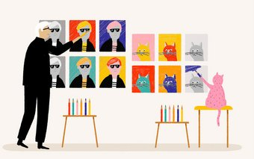
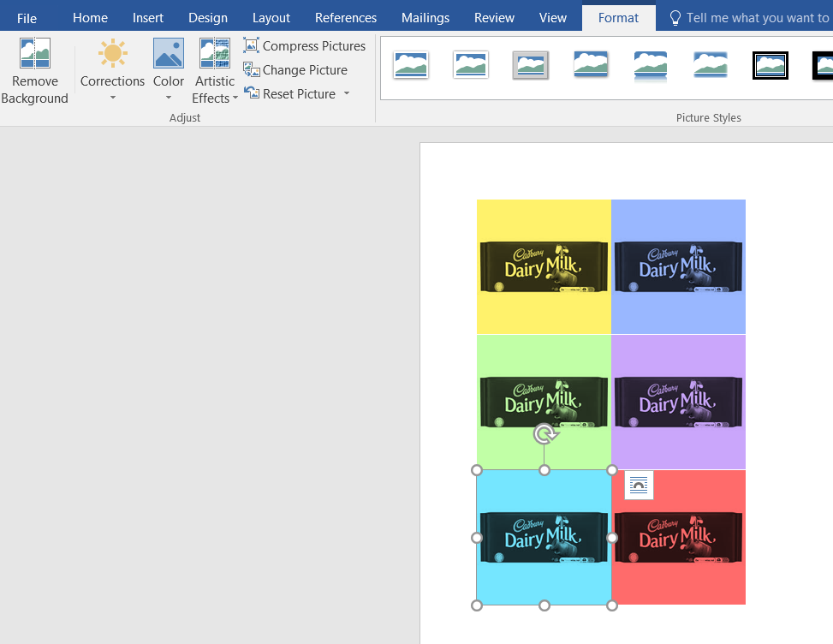
Lets have a go at making our Own Andy Warhol style artwork
I would like us to try and make a digital piece of art work:
You could either:
Take a picture of yourself or an object
Print it out in black and white 6 times
Cut and stick them in a formation
Colour in the eyes, hair and face in bright bold colours using any materials you have at home - pastels, pencils, felt tips, paints, crayons.
REMEMBER to make it bright and bold.
OR
Take a picture of yourself or an object and copy and paste the picture
6 times into Microsoft Word.
Click on one of the pictures and click the ‘Colour’ option.
This will let you choose lots of different colours.
Repeat this for each of your pictures.
1

Slide 8
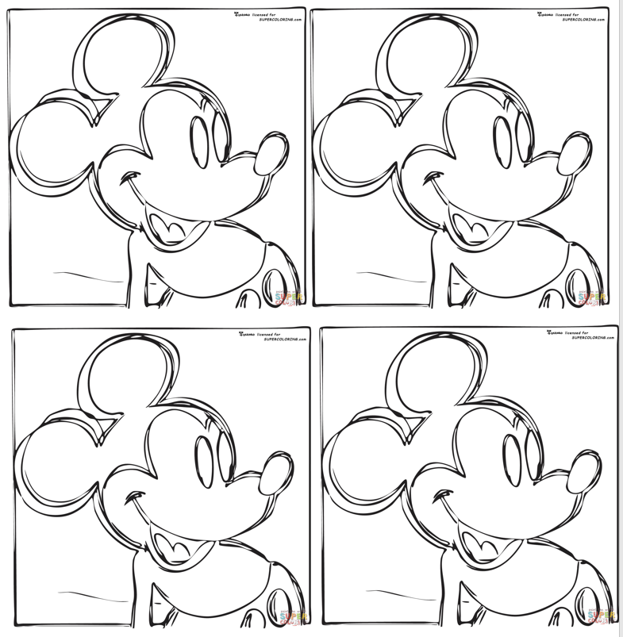
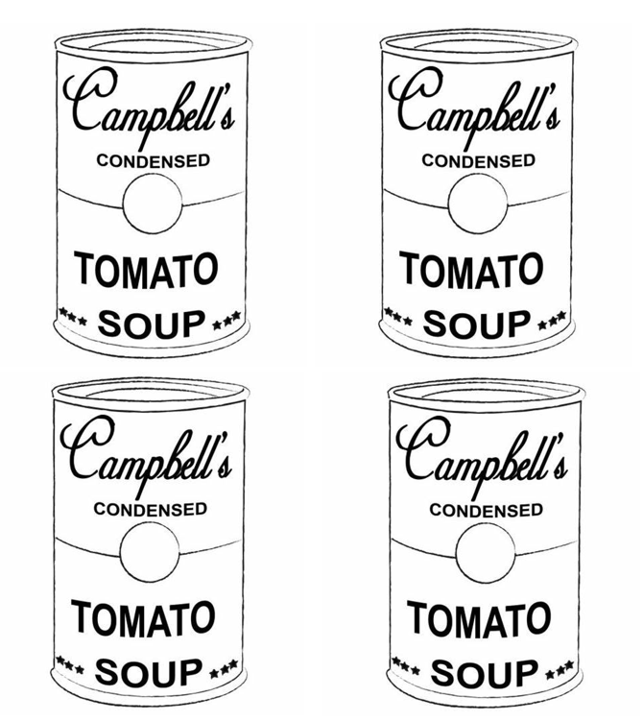
Lets have a go at making our Own Andy Warhol style artwork
If you would rather not make a digital piece of work inspired by Andy Warhol, then you may wish to draw yourself or an object 6 times and colour it in OR you can colour in the attached sheets.

