Slide 1

Learning Adventure
“What inspires a great creation?”

Slide 2
What does inspires mean?
If someone or something inspires you to do something new or unusual, they make you want to do it.
If someone or something inspires you, they give you new ideas and a strong feeling of enthusiasm.

Slide 3
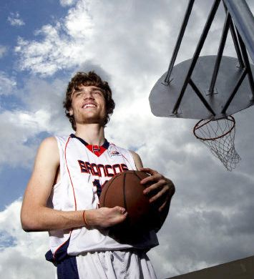
Today we are going to look at an inspirational person.
Steven Claunch

Slide 4
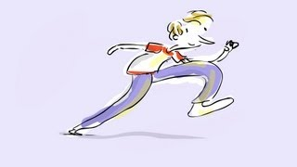
Who is Steven Claunch?
Steven Claunch, was born without fingers on his right hand and with one leg shorter than the other and has excelled in basketball.

Slide 5
Please watch the video of Steven Clauch in the Teams assignment today.
In the video, Steven explains why obstacles can provide an opportunity to both inspire others and develop character.

Slide 6
