Slide 1
Music We are learning to record a simple tune.
I understand how musicians record music.
I can create a simple tune with crotchets and quavers.
I can begin to understand what a ‘staff’ is.

Slide 2
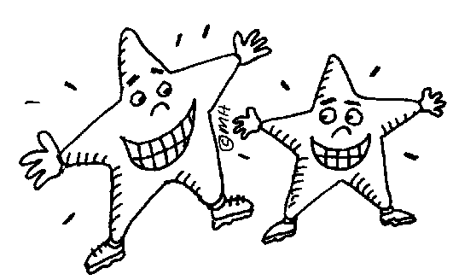
Warm Up
Sing along to the song and clap the syllables.
Twink-le twink-le litt-le star
How I wond-er what you are.
Up a-bove the world so high,
Like a dia-mond in the sky.
(repeat first two lines)

Slide 3
Recap: What is a Pulse?
A pulse is like a steady heartbeat and is heard on every beat of the music.
This is an example of a pulse…
Can you clap it?

Slide 4
Recap: What is a Rhythm?
Rhythms fit inside a pulse.
Try clapping the rhythm below…

Slide 5
Can you put the pulse and rhythm together?
Think of different ways you could make this pulse and rhythm. Perhaps you could clap the pulse and tap with your feet for the rhythm.

Slide 6
Now try a rhythm with half beats in…
Think of different ways you could make this pulse and rhythm. Perhaps you could clap the pulse and tap with your feet for the rhythm.
Two dots in one box make up one beat. This means that they are twice as quick.

Slide 7
How could you do this rhythm?

Slide 8
Musical Notations
Crotchet
Quaver
A crotchet is worth 1 beat:
=
A quaver is worth two ½ beats:
=

Slide 9
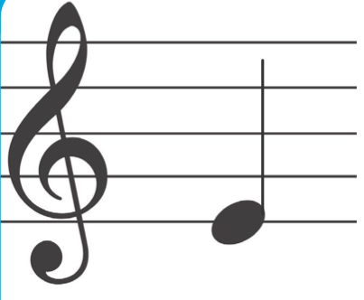
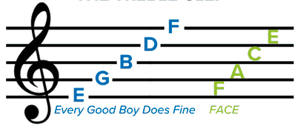
Musical notes go on a staff
Staff
The higher the note, the higher the pitch. The lower the note, the lower the pitch.
Crotchet
Treble clef

Slide 10
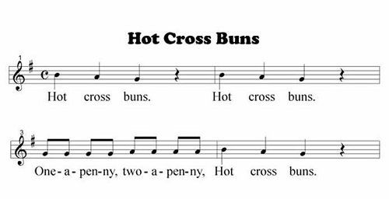
Your Task: Make a simple piece of music using 8 notes or more. You can do this with circles or have a go at drawing crotchets and quavers. Remember to put the beats higher for a higher pitch and lower for a lower pitch. Challenge - add lyrics to your tune.

