Slide 1
Stories in Imaginary Worlds
Lesson 3 – Introducing the characters of the Story set in Narnia.

Slide 2
Support for home and some Top Tips
The aim of this lesson is for the children to create CHARACTERS for their Narnia/imaginary world story.
We suggest that they use the characters that are already in the story, but make them their "own." BUT, you can adapt this, if that is easier.
Top Tips:
* Do lots of acting, pretend to be the characters.
* Discuss what different personalities they could each have.
* Do role play – pretend to interview a character. (Hot seating).
* Draw the characters- this may help you to create the characteristics.
* Decide if you do this assignment/ how you could do it.

Slide 3
L.O. To invent characters with different personalities.
You are going to use the characters that are already in the story of “The Lion, the Witch and the Wardrobe” but you are going to decide what sort of personality you think each has and you are going to be able to describe what they look like.
SUCCESS CRITERIA:
I can create the personality of characters in my story.
I can see what role each character would have in my story.
I can do a written description of a character.

Slide 4
Aslan needs to be a “good” character. The White Witch needs to be the “baddie!”
To recap the main characters:
Four children: Peter, Lucy, Susan and Edmund
Mr Tumnus, (a faun), the Beaver family, the White Witch and Aslan the lion

Slide 5
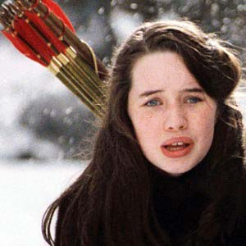
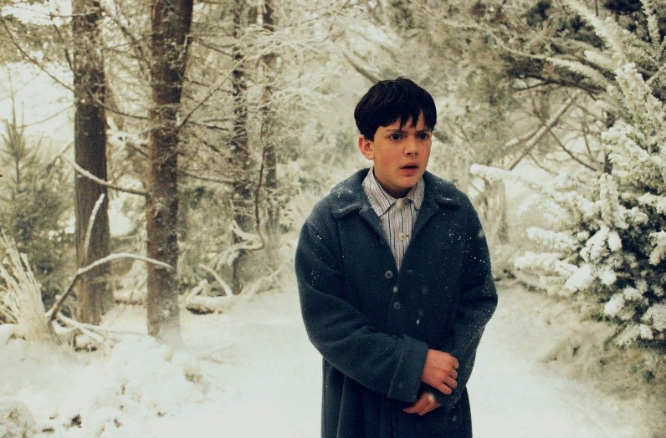
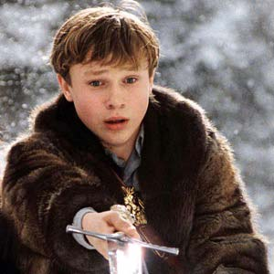
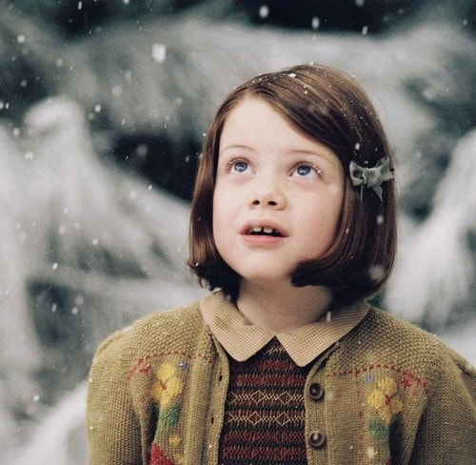
The main characters in the story. Edmund, Lucy, Susan, Peter

Slide 6
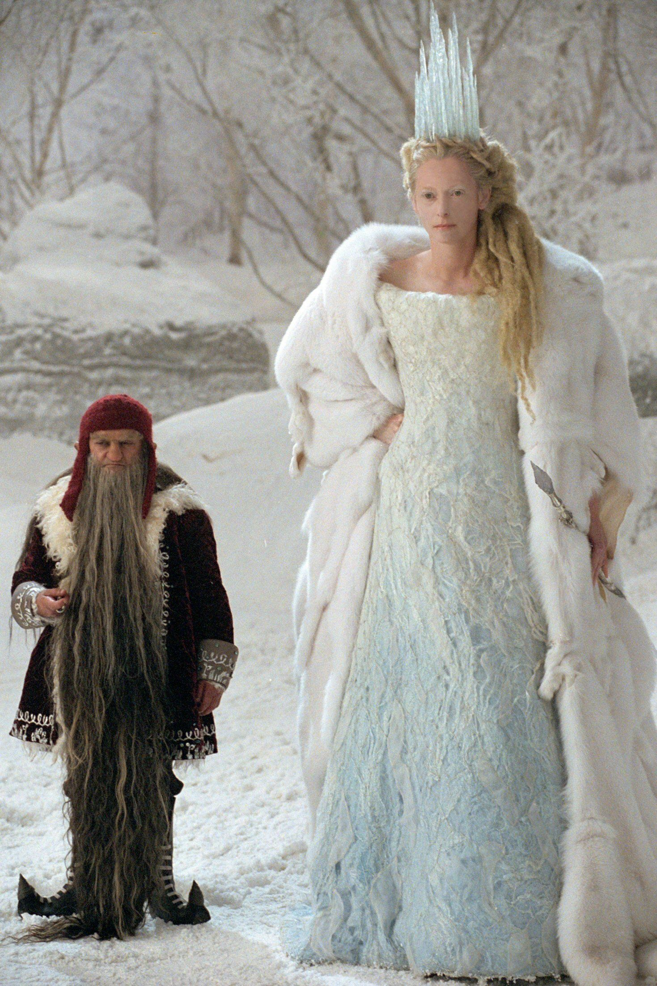
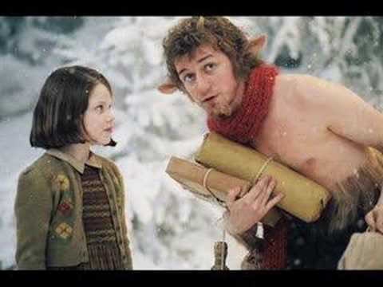
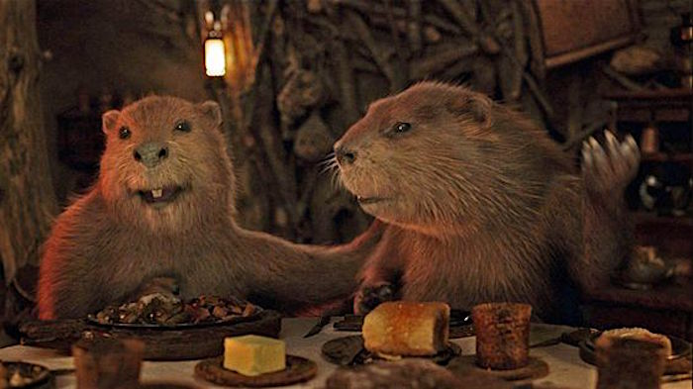
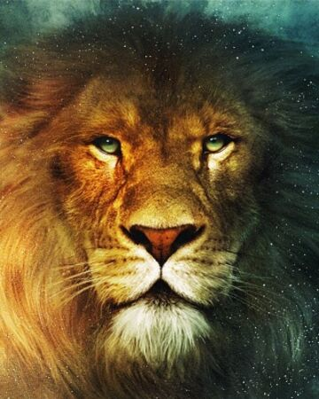
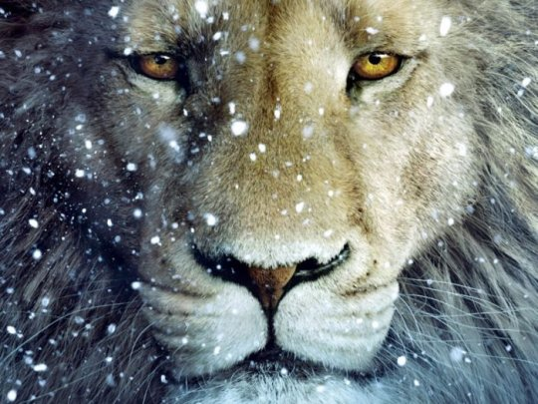
Mr Tumnus, the Beavers, the White Witch and Aslan.

Slide 7
Choose one of these characters.
Jot down some ideas about their character and their physical appearance
EG: Mr Tumnus:
PERSONALITY/CHARACTER
kind, a bit of a worrier, scared of the White Witch
befriends Lucy
is a hero in a quiet, understated way
lives in a cave house
has a family that is lost to him and he will be reunited with them at the end of this story
PHYSICAL APPEARANCE
a faun – half man, half goat
reddish skin, curly hair, a short pointed beard
horns, hooves
goat legs covered with glossy black hair.

Slide 8
This is how I turned my ideas into a piece of writing. Imagine the character appearing for the first time. At this stage it is easier to focus on appearance, but store away the other pieces of information because they will shape the behaviour of that character throughout the story.
Suddenly, an unusual creature appeared in front of Lucy (well, he was certainly unusual to her) and stopped her politely in her tracks.
All she could do was stare at him. He had reddish skin, curly hair, brown eyes and a short pointed beard. Short straight horns grew from his forehead and as she looked down, she was shocked to see cloven hooves and goat legs covered with glossy black hair.
Lucy felt that he had a strange but pleasant little face and as he was only a little taller than Lucy herself, she did not find him frightening or threatening.
He swished his long tail and nervously said, “Hello, daughter of Eve..”
He was as taken aback to see her as she was to see him!

Slide 9
Assignment: Now, it`s your turn to have a go.
TASK (see the assignment with this powerpoint)
Choose one of the characters from the story (as shown in this powerpoint on slides 4 and 5).
Make up your own ideas about their character and their physical appearance. Make some notes, like I did.
Write about the first time that this character is seen or introduced into the story.
Use your imagination. You are using the characters that C.S.Lewis created, but you are making them your own.
This piece of writing will be able to be used when you write your story next week.

