Slide 1
R.E. Pentecost Lesson 2
Learning about Pentecost through art work

Slide 2
In lesson 1, you learned about the events of Pentecost. Can you remember what they were?
Recap:
When Jesus was resurrected, he stayed with the Disciples for 40 days.
He told them that a gift would appear.
On the 50th day, there was fire, confusion and tornadoes!
Flames appeared over the Disciples` heads.
Their gift: that they could speak and understand many languages.
They could spread the word of Christianity.
Many Christians believe that Pentecost is the birth of the Christian Church and it is celebrated 50 days after Easter.

Slide 3
We are going to look at some different art work that tell different parts of the events of Pentecost. You will need to be a good detective to work out clues from the art work. Some of the paintings are modern, some are old. It would be good to look at them all first and then choose one to focus on. Your task is to write down: * what you think the people in the picture are feeling * what the picture tells you about Pentecost or the view of the person who painted it.

Slide 4
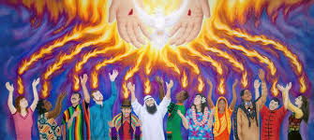
What does this dramatic, modern painting tell us about Pentecost?

Slide 5
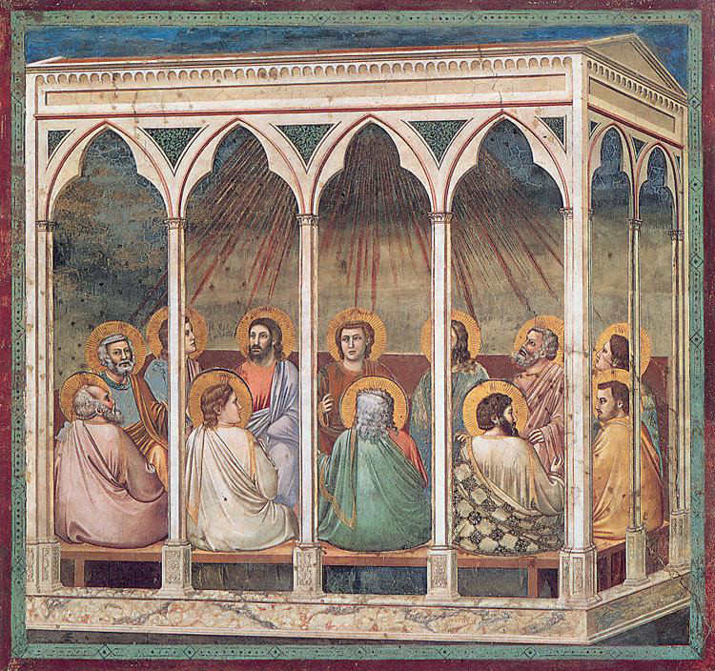
The twelve disciples are in a room when the Holy Spirit descents upon them. This is one of Giotto's frescos in the Arena Chapel in Padua

Slide 6
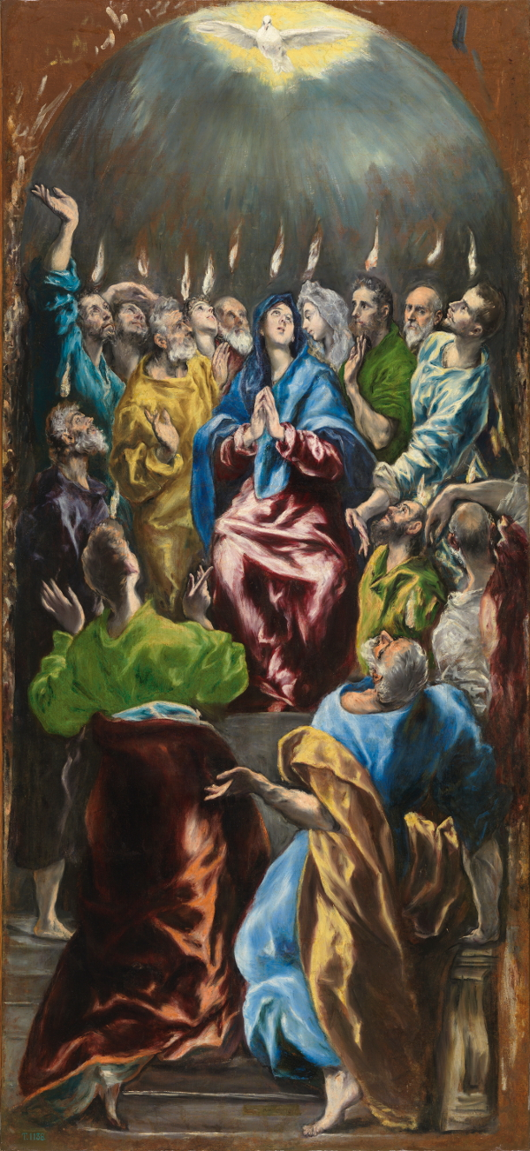
The flames of the Holy Ghost descend on Mary and the twelve apostles. El Greco made this painting as part of an altarpiece for the church of the monastery Lady Mary of Aragon in Madrid.

Slide 7
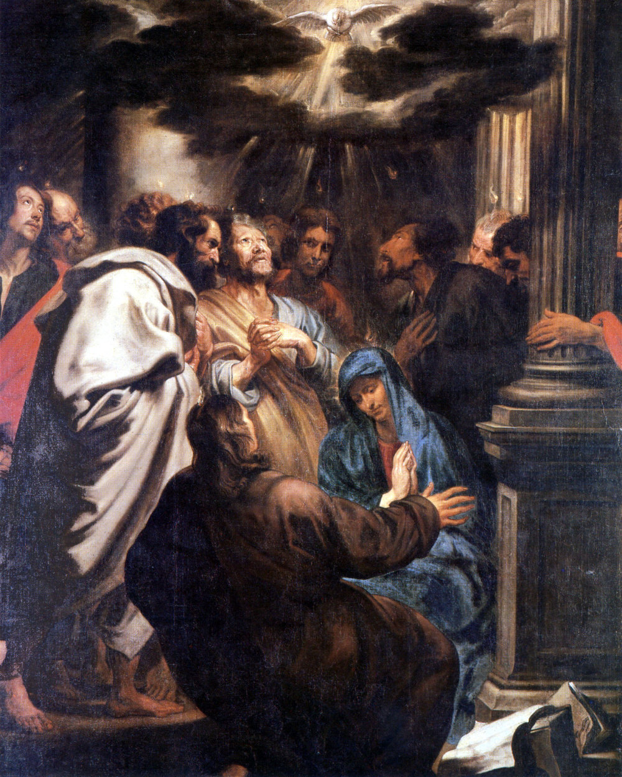
The moment Jesus' followers had been waiting for has finally come: the descent of the Holy Spirit upon them. This painting is also known by its short name Pentecost.

Slide 8
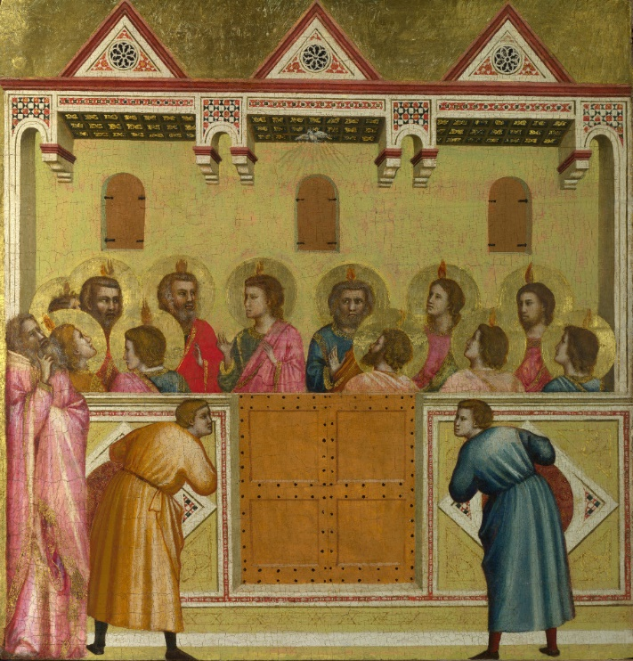
After Jesus' death the twelve apostles have gathered. Here the Holy Spirit descends on them, in the shape of a white pigeon. The twelve are now able to speak in all languages, symbolised by the tongues on their heads. They can now spread the message to all nations. In the foreground men from various countries are amazed when they hear the apostles speak in their languages.

Slide 9
