Slide 1
Science We are learning how sound is affected by different materials.
I recognise that sounds get fainter as the distance from the sound source increases.
I can find patterns between the volume of a sound and the strength of vibrations that produced it.
I can investigate how the volume is affected by different materials.

Slide 2
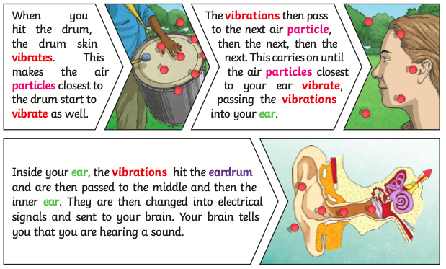
Recap: How does sound work?
There are videos explaining this here:
https://www.bbc.co.uk/bitesize/topics/zgffr82/articles/zx9hcj6
https://www.bbc.co.uk/bitesize/topics/zgffr82/articles/zstr2nb

Slide 3
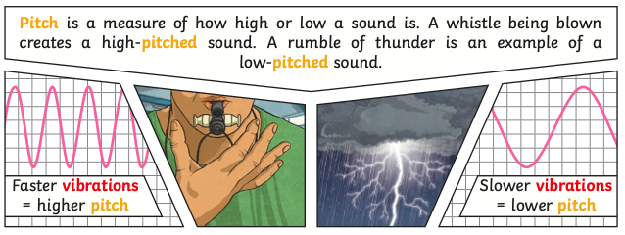
Recap: What is pitch?

Slide 4
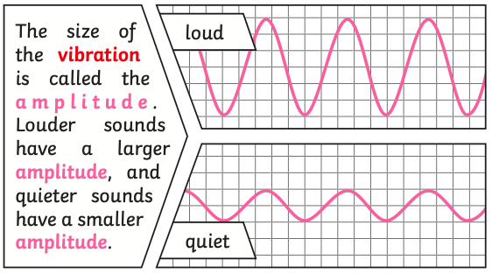
What is volume?
The volume is how loud or quiet a sound is. The further away we are from something, the quieter the sound. Below shows how this works.

Slide 5
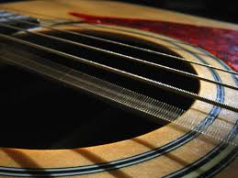
How does sound travel through different materials?
Sound can travel through solids, liquids and gases. Sound travels as a wave, vibrating the particles in the medium it is travelling in. Sound cannot travel through a vacuum. This means, if there is no air, there is no sound.

Slide 6
Mr Quiet’s Problem
Mr Quiet likes the quiet life. He lives, quietly, in a small little cottage in the middle of a wood. The problem is that his small, little cottage is in the middle of a country called Loudland!
Everything and everybody in Loudland is noisy. Dogs don’t go “woof” like dogs you know. They go, “WOOF!”
People don’t shut their doors like us. They slam them - BANG!
People don’t talk to each other. They shout at each other. “HELLO!” they shout as they meet in the street.
Mr Quiet doesn’t like all the noise. The noise frightens him.
How can we help Mr Quiet?

Slide 7
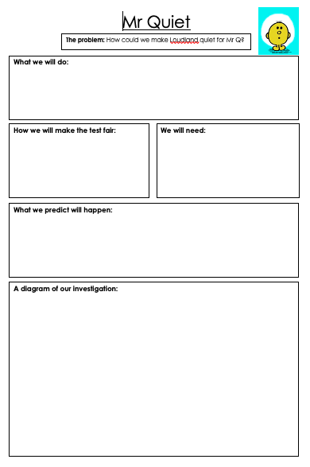
Your task:
Today, we are planning an investigation on how different materials change the volume of sound. We are helping Mr Quiet in Loudland by making earmuffs out of different materials. The best material for Mr Quiet will be the one that makes it quietest for Mr Quiet.
There is a planning sheet that you can use, or you can create your own investigation sheet. Next week, we will be carrying out our investigation so you will need a good plan.

Slide 8
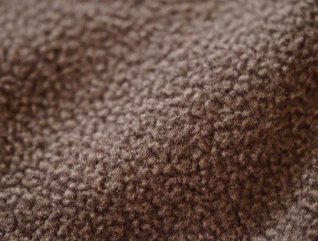
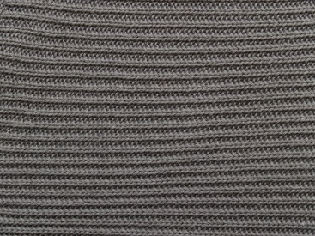
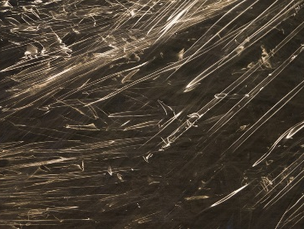
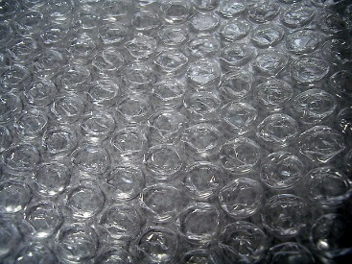
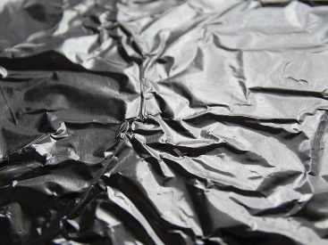
Here are some materials you could use:
cotton wool
towel
fleece
paper
wool
cling film
kitchen roll
cotton
bubble wrap
tinfoil

Slide 9
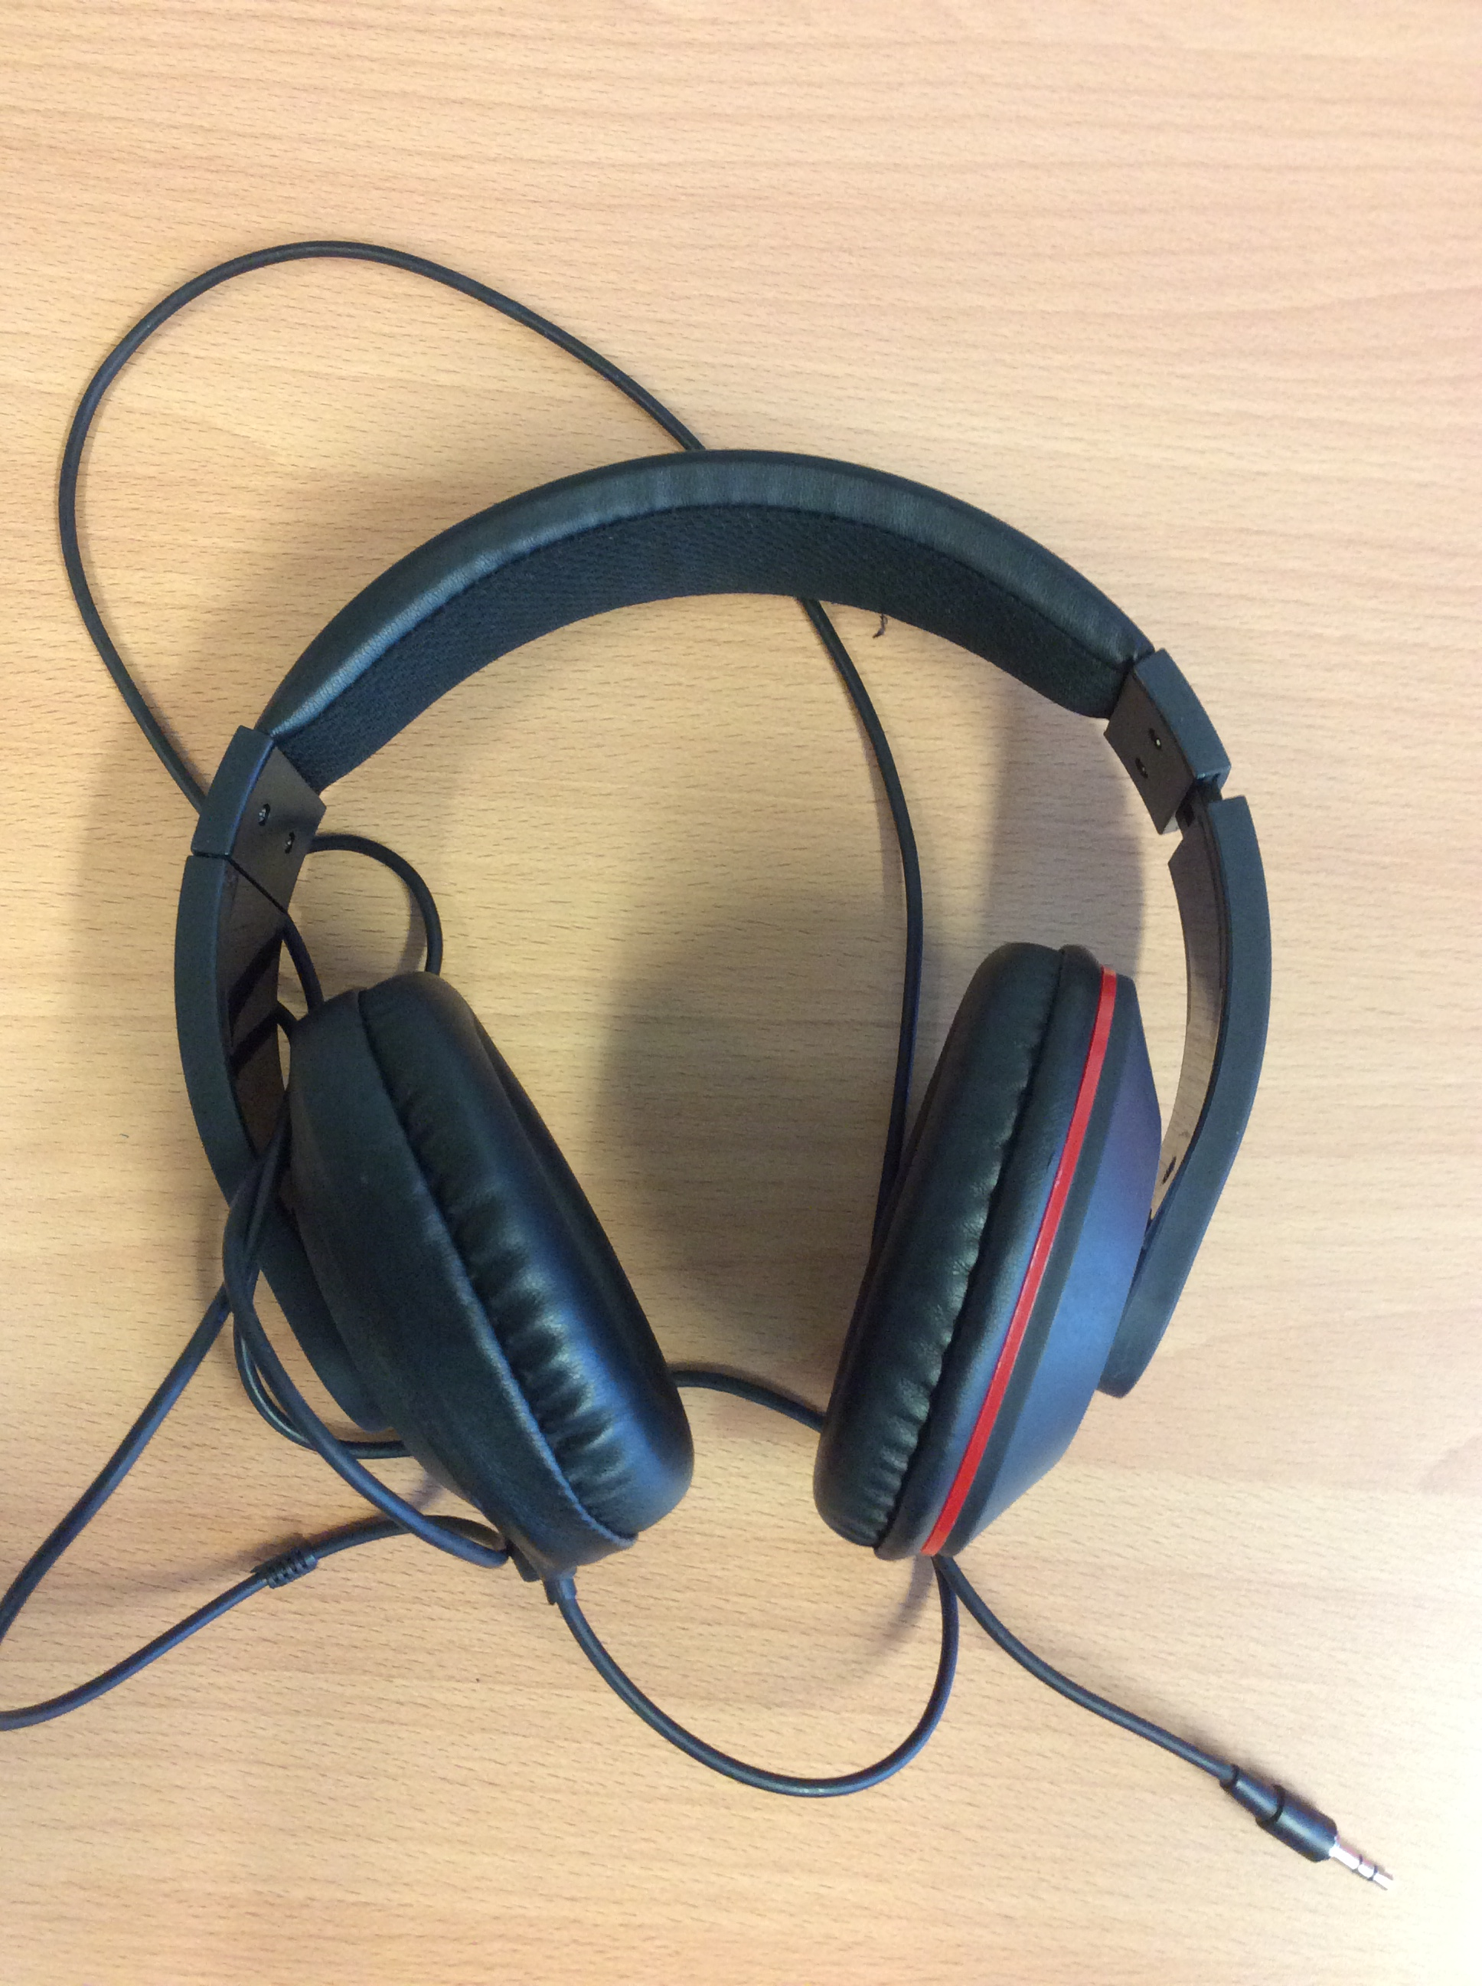
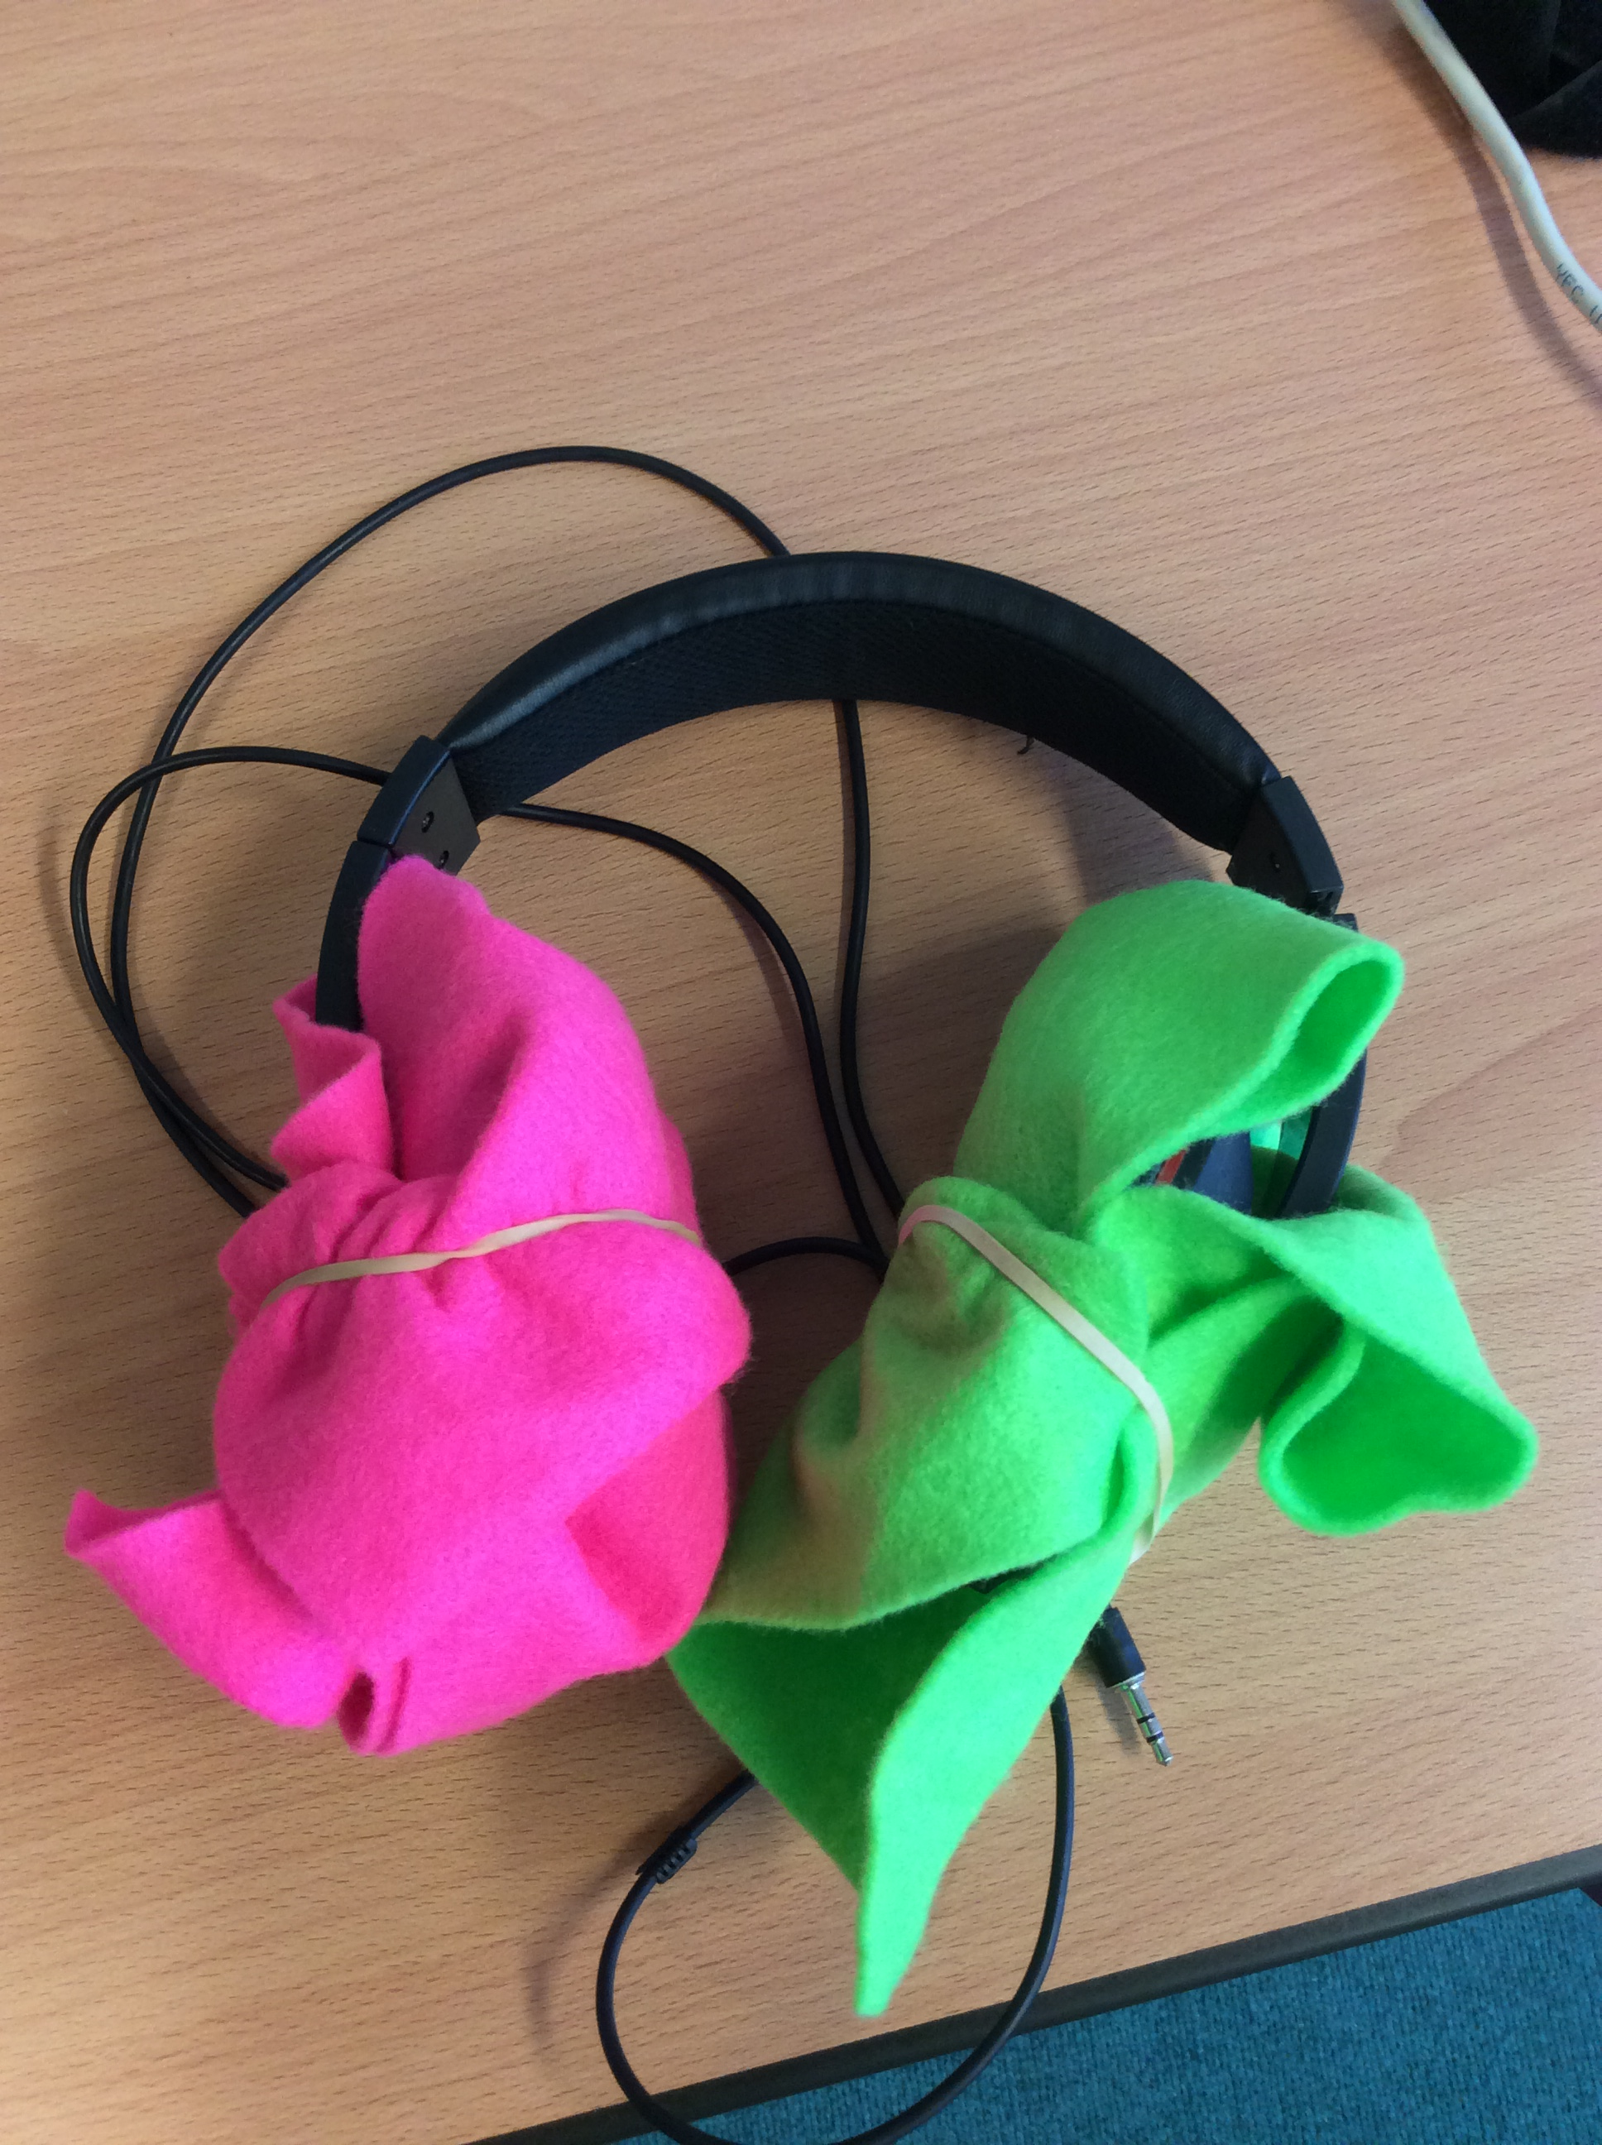
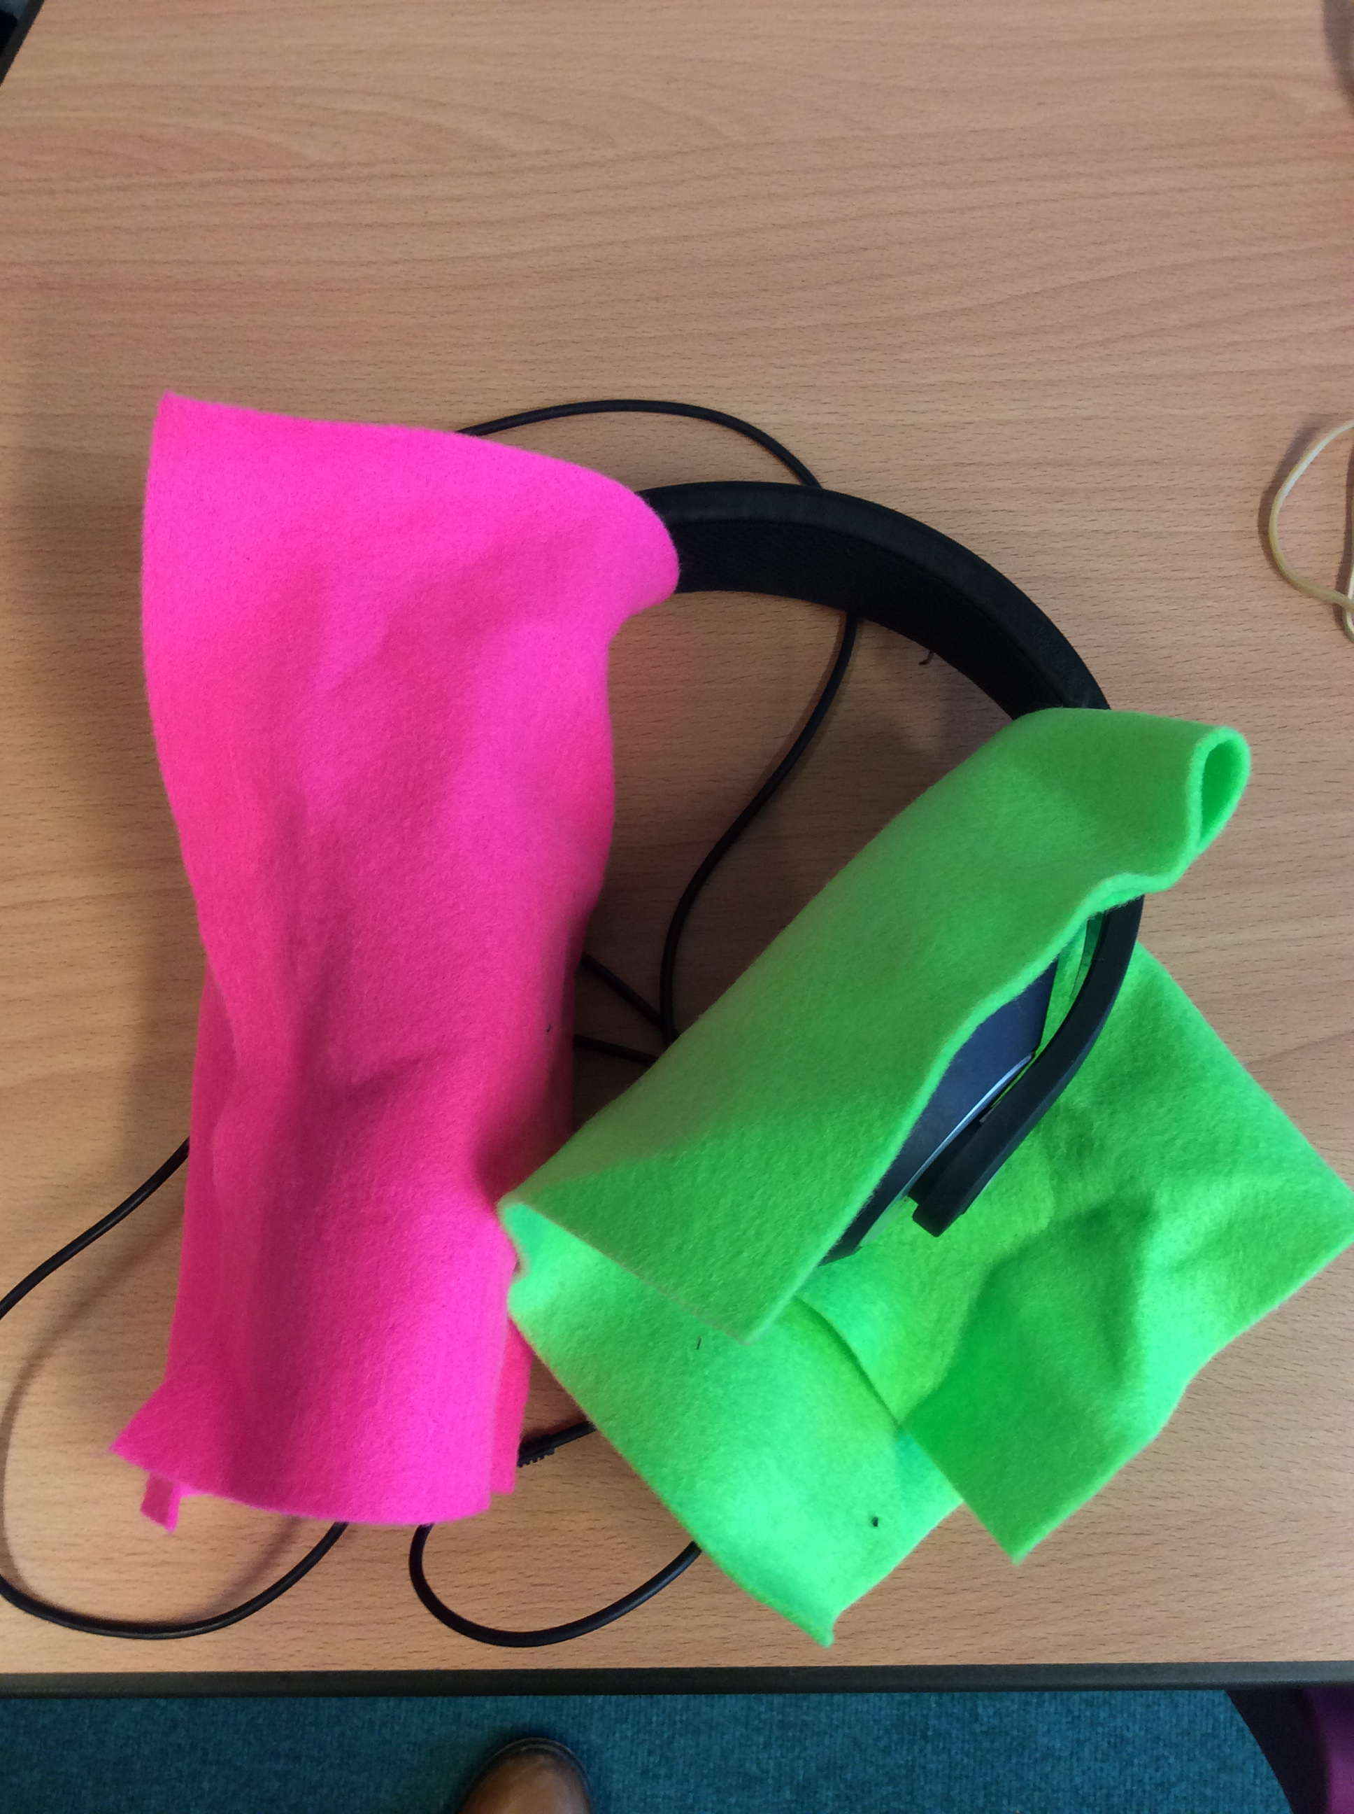
Here is how you could make your earmuffs:
Option 1
DO NOT PUT ANYTHING INSIDE YOUR EARS FOR THIS!
Cut a piece of material out to wrap around the headphones.
Secure with an elastic band.
Get a pair of headphones.

Slide 10
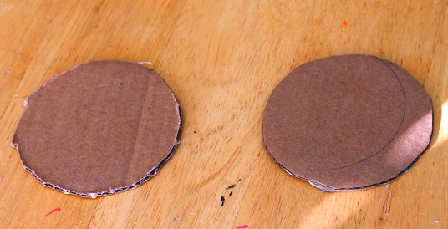
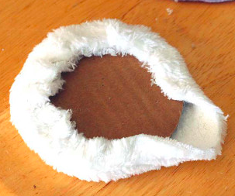
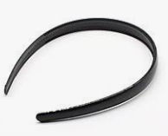
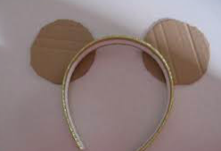
Here is how you could make your earmuffs:
Option 2
DO NOT PUT ANYTHING INSIDE YOUR EARS FOR THIS!
Make a pair of earmuffs by cutting two pieces of cardboard out and securing to a headband or piece of cardboard.
Wrap material around the cardboard.
Secure with elastic band.

