Slide 1

Poetry - Lesson 1
We are learning to discuss the different features in poetry.
I can discuss the different features of a poem.
I can say what poem I like and why.
I can say what a shape poem is.

Slide 2
There are many different types of poetry:
Limerick
Nonsense poem
Free verse poem
Rhyming poem
Narrative poem
Shape poem
Acrostic
https://www.bbc.co.uk/teach/class-clips-video/english-ks1-ks2-understanding-poetry/zfvkt39

Slide 3
This week, we are looking at shape poems. These are poems in the shape of something. Many have other features as well. Today, we are discussing these different features.

Slide 4


Theme
A theme is a key idea explored in a poem (or a play or story). There can be more than one theme developed in a piece of writing. These are some examples:
love
nature
travel
dreams
celebration
family
animals

Slide 5

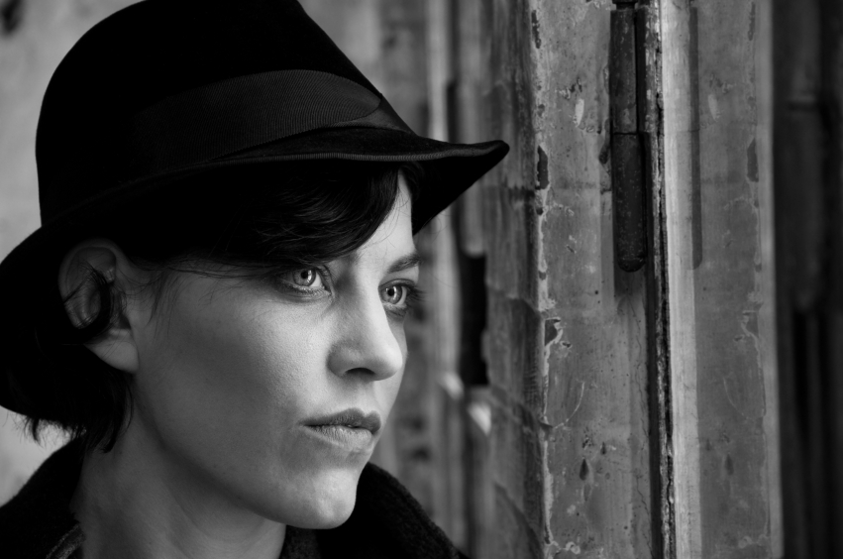
Tone
Tone is the attitude or emotion of the poet or writer in their writing. If they are talking about a death, the tones might be sombre and serious. If they were writing about love there may be romantic and happy tones.

Slide 6
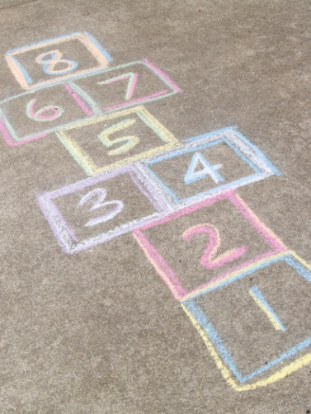
Mood
The mood is the feeling or atmosphere created by the poet in a particular time or place. E.g. A poem may begin with a playful atmosphere but then as the poem develops the atmosphere could change to eerie, or bad (playground → Principal’s office).

Slide 7
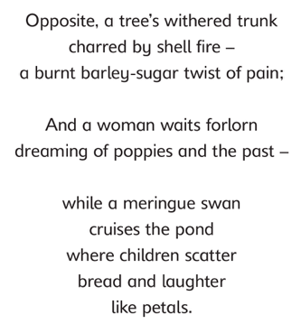
Imagery
Imagery is the author’s use of language that appeals to the five main senses (touch, taste, sound, sight, smell) in order to help the reader imagine exactly what is being described. See if you can spot any of the senses in this extract of a poem.

Slide 8

Simile
Comparing two words or terms using like or as.
For example, ‘her face was as white as a ghost’.

Slide 9
Rhythm
Rhythm can be described as the beat and pace of a poem. It is just the same as with a piece of music and can be quick or slow.

Slide 10
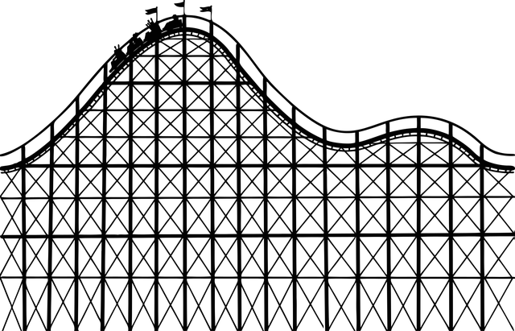
Metaphor
A comparison between two basically unlike things, without using the words like or as. One thing is said to be another.
Example: Life is a rollercoaster.

Slide 11

Rhyme
Rhymes are words that sound similar to each other when you say or hear them.
Example:
“Twinkle, twinkle little star,
How I wonder what you are.”

Slide 12
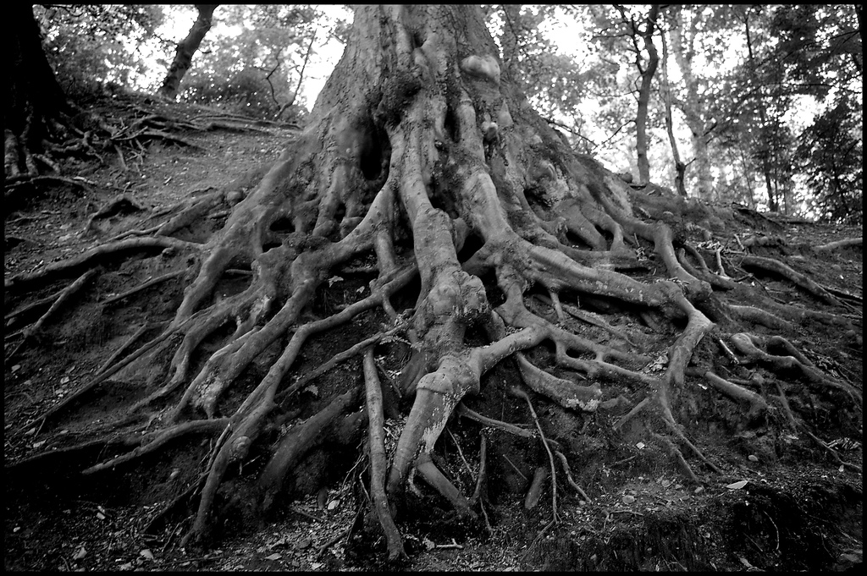
Personification
The giving of human qualities to non-human things.
Example: The tree roots grabbed at my ankles and pulled me down to the ground. I was trapped under their firm grasp in the deep, dark woods.

Slide 13
Your Task:
Look at the shape poems on the worksheet and answer the following questions:
1. What is the poem about?
2. Who is speaking? To whom?
3. How does the poem sound? What is the rhythm?
4. What images does the poet use?
5. Are there any noticeable words?
6. List any poetic techniques used (rhyme, imagery, personification).
7. What is the mood of the poem?
8. Why do you think the poet has written the poem?
9. Do you like the poem? Why? Why not?

Slide 14
Extra Challenge!
Choose another poem. There are some here: https://www.bbc.co.uk/bitesize/topics/z4mmn39/resources/1
What’s similar to the shape poems? What’s different? Which do you prefer? Why?

