Slide 1
MAKING A PRESENTATION
Make a presentation on something that inspires you, something you love, something you feel passionate about.

Slide 2
Some of you have asked, during the Lockdown, if you could undertake your own mini project on something that inspires you/captures your interest.
You do not have to do this – it is optional.
If your parents decide that it would be nice for you to do this optional extra, then they may decide that you spend more time on this and less time on the other tasks that we have given you.
It would be really nice if at the end of this term (whether we are all back at school or not) that everyone produces an exciting piece of work that you could share with your friend/ a group or your class.
It can be as big or as small as you wish it to be.
You have to “teach us something/pass on some knowledge.”

Slide 3
Decide how you want to present your mini project.
You may wish to do a POWERPOINT PRESENTATION and we have included some instructions to help you do this – if you don`t already know how to.
It could be a piece of art work with some written information alongside it.
It could be on paper in the form of a scrap book with information/pictures/bits and pieces stuck in.
You might want to do it as a video presentation – some of you have already sent in your work in this form.
You might want to create a 3D model or sculpture.
There are probably lots of other ways and we are happy for you to decide how you will do yours.

Slide 4
The next few slides give some screenshot instructions on how to make a powerpoint presentation. If you do not want to do your mini topic in this way, then skip to Slide…
HOW TO MAKE A BASIC POWERPOINT PRESENTATION

Slide 5
How to begin: Find the Powerpoint icon on your computer or device. (see blue arrow).

Slide 6
Select the background style you want.

Slide 7
This is what the first page looks like.

Slide 8
Write your title and a sub-heading on the first slide.

Slide 9
To make a new slide, click on “New Slide.”

Slide 10
You have different choices for slides. I advise the one that says “Title and Content” because you can put in text and pictures (images).

Slide 11
You can copy and paste a picture into the slide. (You would need to go into Google so make sure an adult is with you.)

Slide 12
If you choose a new slide that says “Title and Content,” you can add some text that gives more information about the subject.

Slide 13
At the end, it is fun to go to “Animations” where you can try out different ways to make your text appear.

Slide 14
You can also change the colour of the background so that is not white. “Go to Design.” I usually go to “Format Background,” choose a colour and then “Apply to All.”

Slide 15
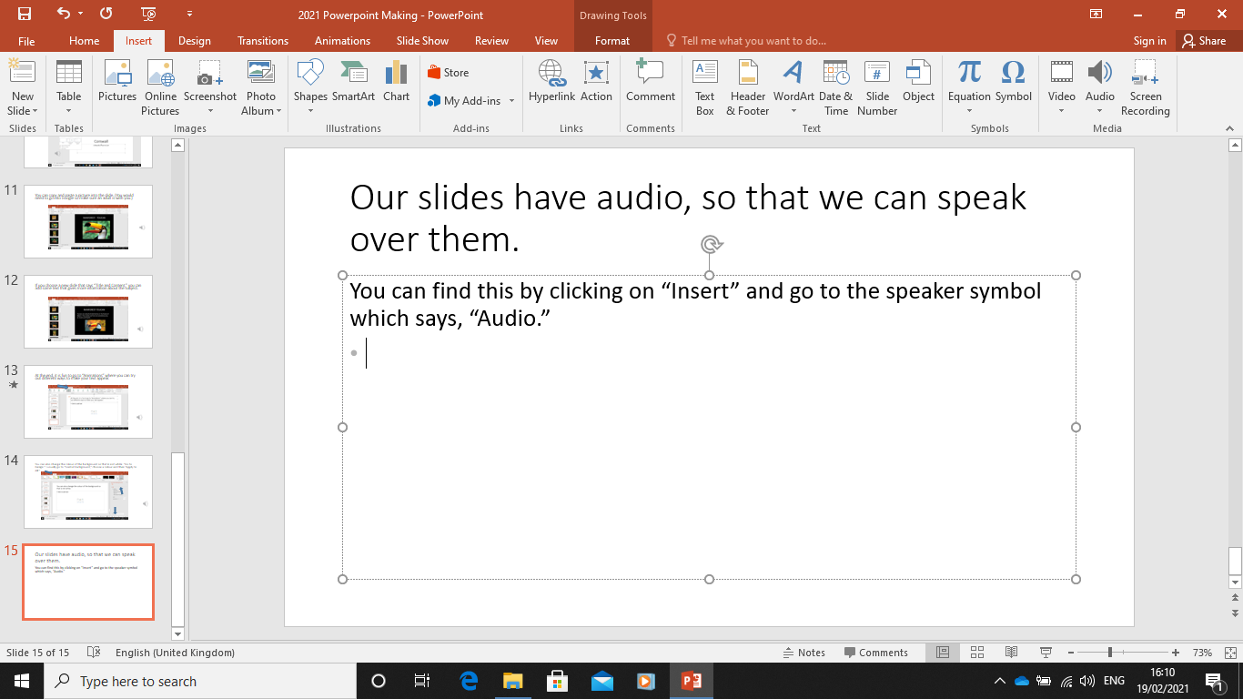
Our slides have audio, so that we can speak over them.
You can find this by clicking on “Insert” and go to the speaker symbol which says, “Audio.”

Slide 16
ASSIGNMENT: To create a presentation on any topic of your choice.
This powerpoint is on your Teams Assignment and on the Blog, but there will not be an editable assignment with it because you can decide how you want to present it yourself.
Have fun and we look forward to seeing your presentations when we are all back together again.
This task is OPTIONAL.

