Slide 1
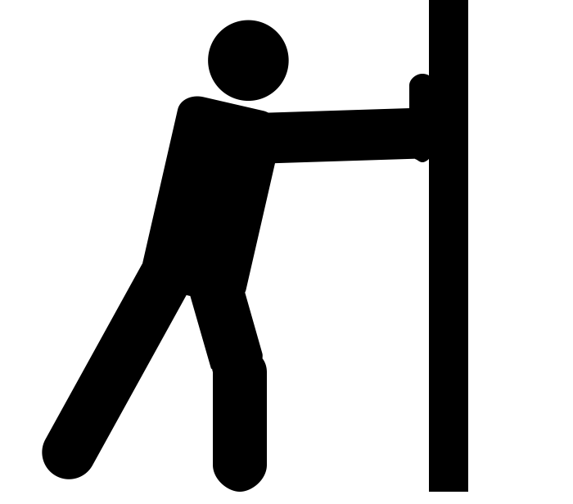
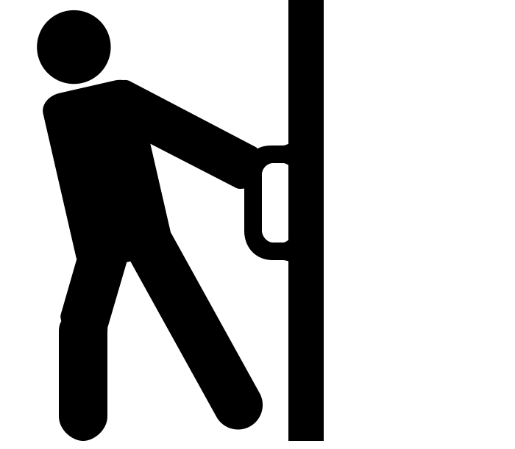
What are forces?
Science - Forces
Miss Hummel
push by Rohan Gupta from the Noun Project
pull by Rohan Gupta from the Noun Project

Slide 2
STAR WORDS
⭐
⭐
Push
Forces
⭐
⭐
Pull
Air resistance
Friction
⭐
Water resistance
Upthrust
⭐
Magnetic
Gravitational
⭐
⭐

Slide 3
Forces are a push or a pull on an object.
Push by Rohan Gupta from the Noun Project
Pull by Rohan Gupta from the Noun Project

Slide 4
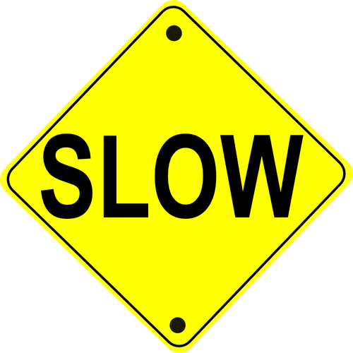
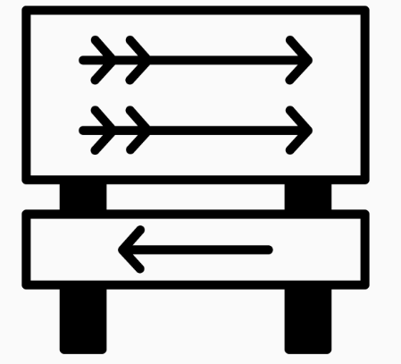
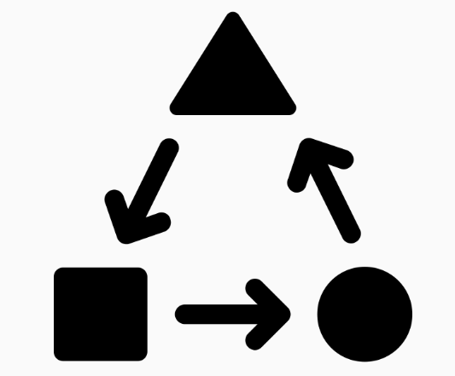
When a force pushes or pulls on an object it can do three things to that object:
Speed it up or slow it down
Change its direction
Change its shape
fast forward by Thomas Le Bas from the Noun Project
Public Domain Vectors
arrows by Royyan Razka from the Noun Project
transform by Adrien Coquet from the Noun Project

Slide 5
Pause the video to complete your task
Note-taking task:
Write down the definition of a force and write the three things it can do to an object.
Resume once you’re finished

Slide 6
Contact forces
There are lots of types of forces that can act on an object. Sometimes these forces only take place if two objects are touching. We call these forces contact forces.
Examples of contact forces include:
friction
air resistance and water resistance
upthrust
Touch by iconsphere from the Noun Project

Slide 7
Friction
Friction is a force between two surfaces that are sliding, or trying to slide, across each other.
Friction always slows a moving object down.
Public Domain Vectors

Slide 8
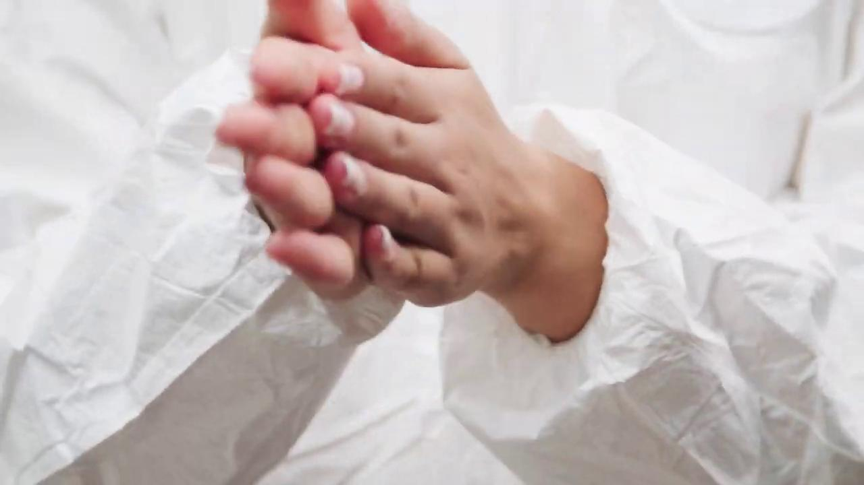
Friction
Can you think of any action which would result in friction?
Pexels

Slide 9
Air resistance
Air resistance is a type of friction between air and another material.
Air resistance acts when something tries to move quickly through air.
Public Domain Vectors

Slide 10
Air resistance
Pixabay
Pixabay

Slide 11
Water resistance
Water resistance is a type of friction between water and another material (same as air resistance).
Public Domain Vectors

Slide 12
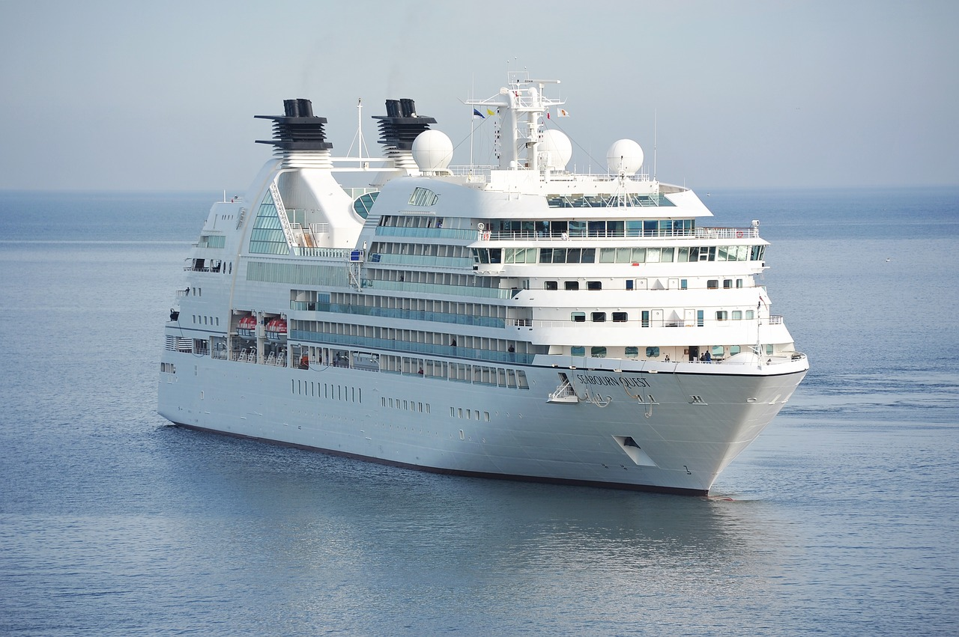
Water resistance
Pixabay
Pixabay

Slide 13
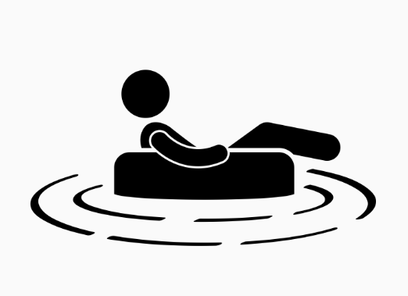
Upthrust
Pushes objects upwards on objects that are in water.
floating by Gan Khoon Lay from the Noun Project

Slide 14
Pause the video to complete your task
Answer this question:
What were the four examples of contact forces?
Resume once you’re finished

Slide 15
Non-contact forces
For other forces, they will act even if two objects are not touching. We call these forces non-contact forces.
No touching by icon 54 from the Noun Project

Slide 16
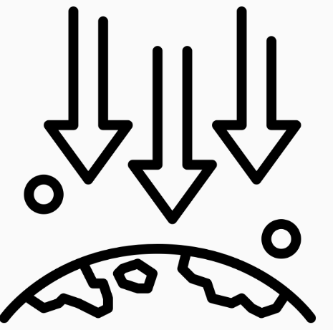
Gravitational Force - Weight
Pulls everything downwards towards the earth.
Gravity by tulpahn from the Noun Project

Slide 17
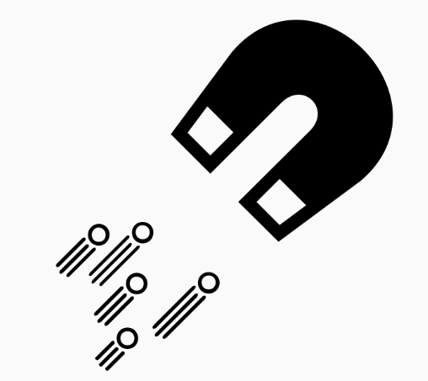
Magnetic Force
Which makes magnetic objects:
attract (pull together) each other
repel (push away) each other
Magnetic Field by Robin Will from the Noun Project

Slide 18
Pause the video to complete your task
Answer this question:
What are two examples of non-contact forces?
Resume once you’re finished

Slide 19
Match the words
Air resistance
Gravitational force
Friction
Magnetic force
Upthrust
- pushes objects upwards on objects that are in water.
- pulls everything downwards towards the earth.
- acts when something tries to move quickly through air.
- acts between two surfaces that are sliding, or trying to slide, across each other.
- makes magnetic objects attract or repel each other.

Slide 20
Answers
Air resistance
Gravitational force
Friction
Magnetic force
Upthrust
- pushes objects upwards on objects that are in water.
- pulls everything downwards towards the earth.
- acts when something tries to move quickly through air.
- acts between two surfaces that are sliding, or trying to slide, across each other.
- makes magnetic objects attract or repel each other.

Slide 21
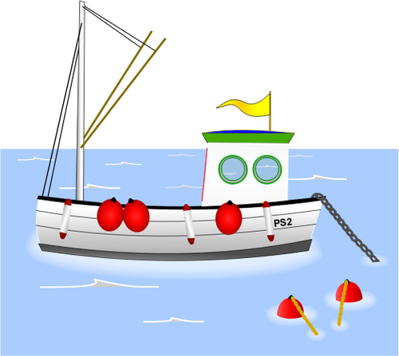
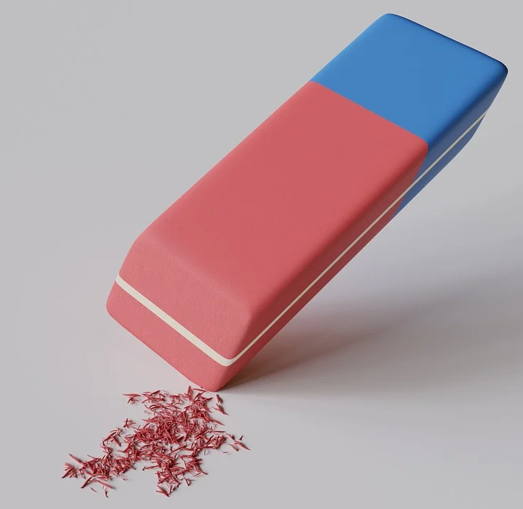
Which force is shown in each of the diagrams below:
🍎
🧔
Pixabay
Public Domain Vectors

Slide 22
Answers:
🍎
🧔
Gravitational force
Friction
Water resistance
Pixabay
Public Domain Vectors

Slide 23
