Slide 1
Diaries - Lesson 4 We are learning to brainstorm ideas for what the characters can do in ‘Wonderland’.
I can discuss what the characters are like in Alice in Wonderland.
I can begin thinking of ideas for my diary entry.

Slide 2
Alice in Wonderland Story
Read through the Alice in Wonderland story again or watch the video here: https://www.youtube.com/watch?v=cNpuWQVeiOU
Who are the main characters? What are the like? Are they friendly? Mean? Clever? Scary? Happy? How do you know?
If you’re note sure the answer to these questions, then watch or read the story again.

Slide 3
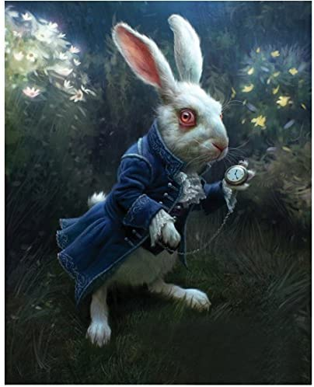
The White Rabbit
How would you describe the White Rabbit?
Anxious - He is very worried that he’s going to be late and talks about this a lot in the story.
Scared - He is scared of the Queen of Hearts.
Rude - He is not very nice to Alice in the beginning.
Quick - Alice has to race after him

Slide 4
The White Rabbit
What does the White Rabbit do in Wonderland?
What other things could he do in Wonderland?
Have a think about this - you might want to write some ideas on a scrap piece of paper or share your ideas with someone else.

Slide 5
The White Rabbit
What the White Rabbit does:
Goes home and orders Alice to fetch his gloves and a fan.
Is late for the Queen of Hearts.
He is a herald in the Queen of Heart’s court.
He shows Alice around Wonderland without meaning to.
What the White Rabbit could do:
Go on a secret mission for the King of Hearts
Be late for another event: wedding, court case, opening of a palace/castle
Plan a game like the Queen’s croquet or chess

Slide 6
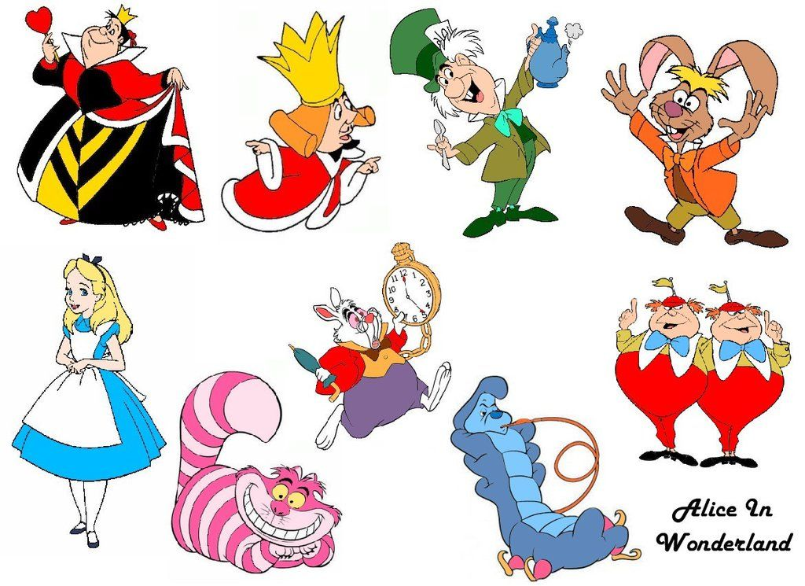
Your task:
Choose 3 main characters in Alice in Wonderland. Around the character, draw a mind map of what your character does or could do in Alice in Wonderland. This will help you when you come to plan a diary entry of one of the characters in Wonderland.

