Slide 1
14.03.22
We are learning to compare numbers up to 50

Slide 3
equal to
less than
equal to
less than
greater than
less than
greater than
greater than
These are not easy!
We can figure them out together!
less than
twenty-seven is ___________ 49
fifteen is __________ fifteen
equal to
less than
1 ten and 4 ones is ___________4 tens and 1 ones
greater than
41 is ____________ 14

Slide 5
Have a think
Comparing using symbols
=
=
>
=
>
>
<
<
twenty is 2 tens and 3 ones
50 is 40 $+$ 8
19 is 1 less than 18
twenty-nine is 30 $−$ 1

Slide 7
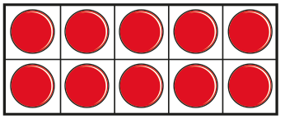
Have a think
What symbol needs to go in here to make this number sentence correct?
>
Two tens and nine ones
What number is this?
What number have I made with the ten frames?

Slide 8
What numbers can we put into this table to make it correct?
 | is greater than
 | <
 | =

