Slide 1
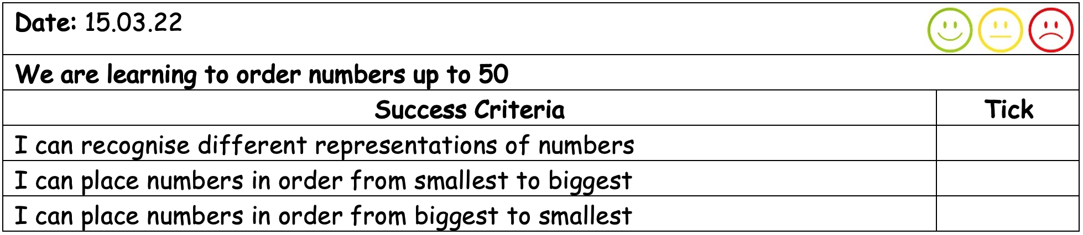
15.03.22
We are learning to order numbers up to 50

Slide 2
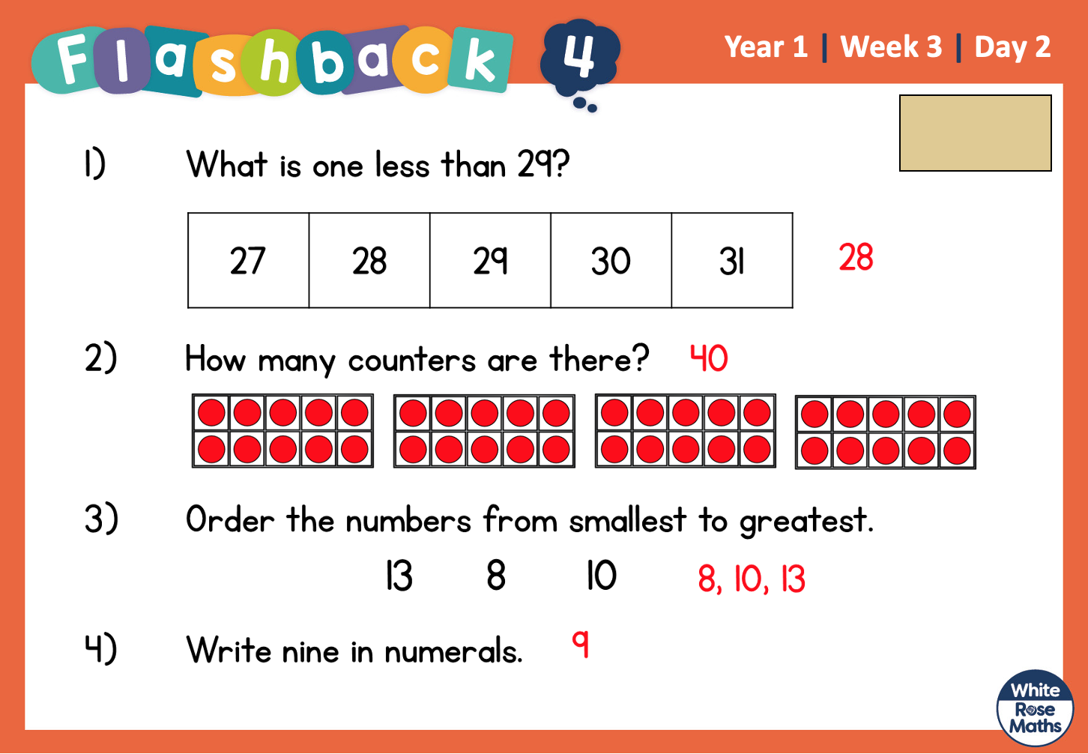

Slide 3
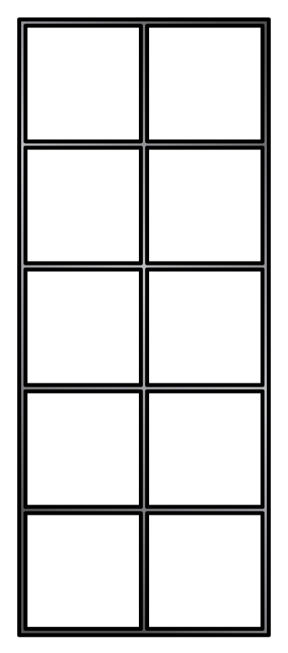
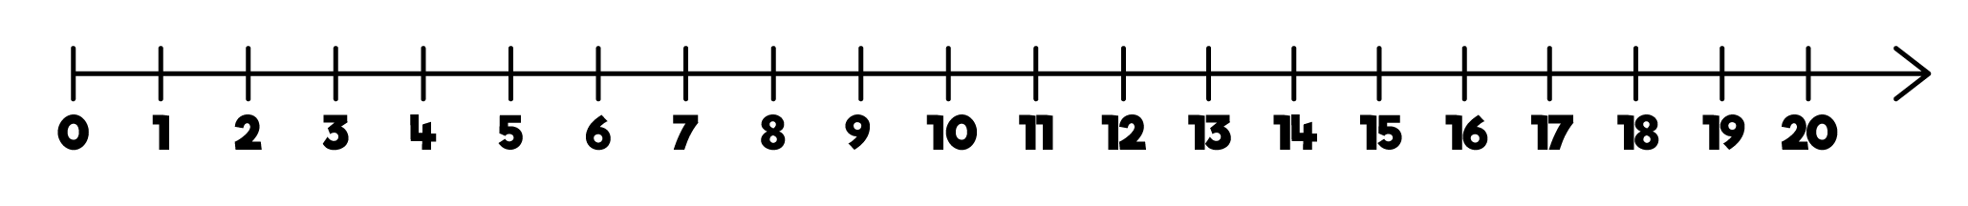
Ordering from smallest to greatest
Before we put our numbers in order, what do we need to do first?
thirteen
16
8, 11, 13, 16

Slide 4
Ordering from greatest to smallest
Before we put our numbers in order, what do we need to do first?
nineteen
17
19, 17, 14, 9

Slide 5
Before we put our numbers in order, what do we need to do first?
Comparing tens and ones
36
33
38
smallest to greatest
Notes:
How many ways can you describe a number?

Slide 6
Before we put our numbers in order, what do we need to do first?
Comparing tens and ones
36
43
28
smallest to greatest
Notes:
How many ways can you describe a number?

Slide 7
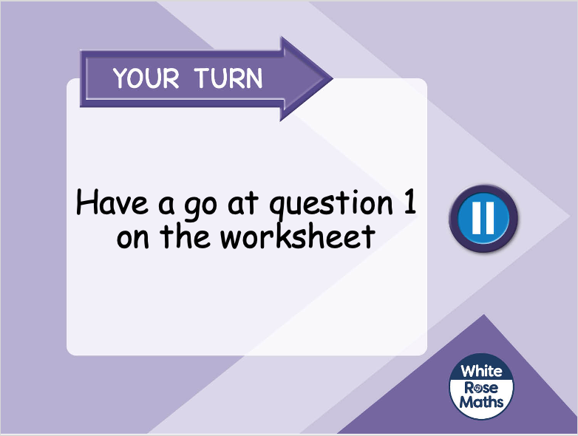

Slide 8

Ordering numbers
Have a think
28
18
48
8
smallest to greatest

Slide 9
Ordering numbers
Have a think
46
41
40
49
greatest to smallest

Slide 10
Ordering numbers
Have a think
6
31
50
Where would these numbers go?
48
19
25

Slide 11
