Slide 1
16.03.22
We are learning to count in twos

Slide 3
Let’s learn to count in twos!
https://www.youtube.com/watch?v=OCxvNtrcDIs

Slide 4
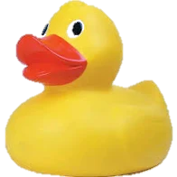
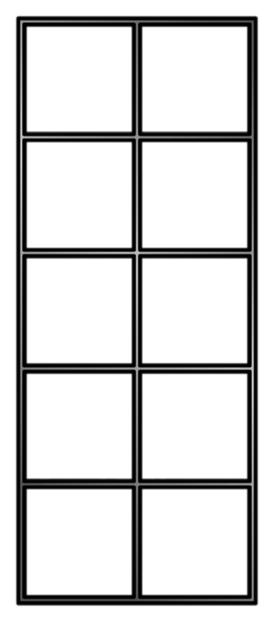
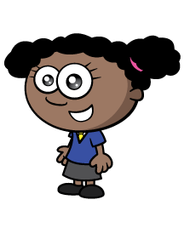
How many ducks?
Now I can count by 2s!
2 , 4 , 6 , 8
There are 8 ducks.

Slide 5
How many clouds are in each group? Why?
2
4
6
8

Slide 6
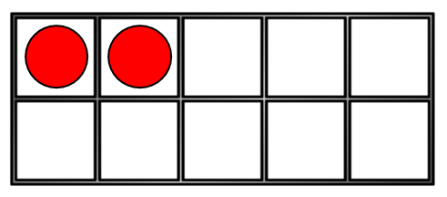
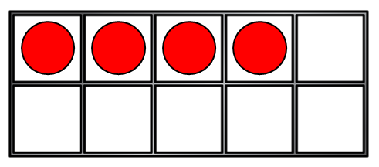
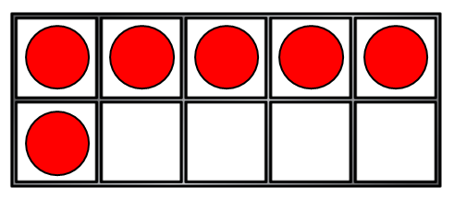
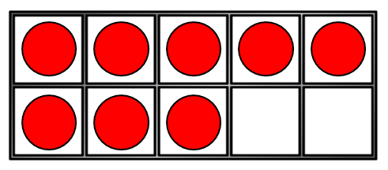
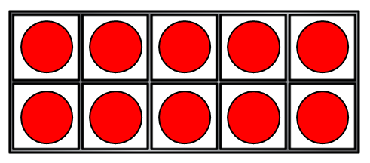
How many counters?
0
2
4
6
8
10

Slide 8
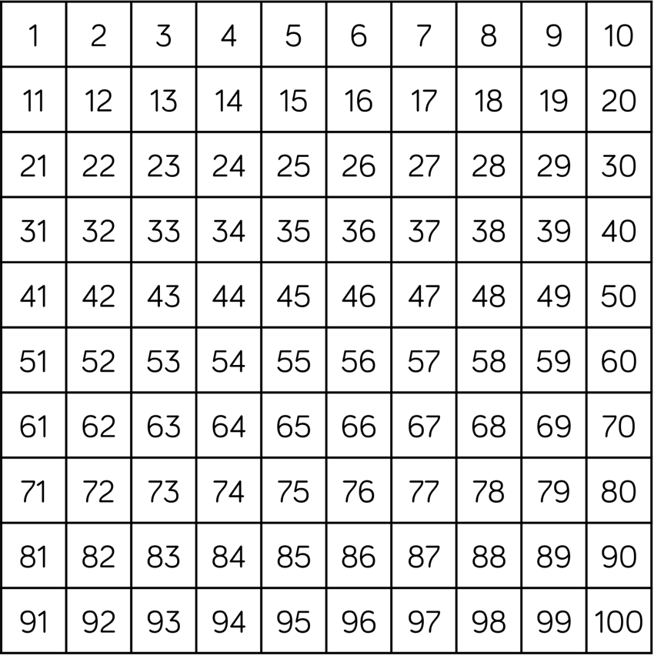
Have a think
How many gloves?
There are 20 gloves.

Slide 9
Have a think
Can you count in 2s starting at 8?
There are 20 eyes!

Slide 10
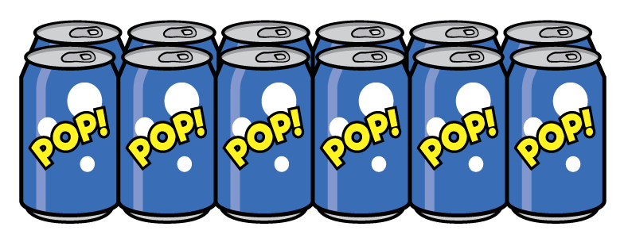
Have a think
How many pencils?
16
How many cans of pop?
12

Slide 12
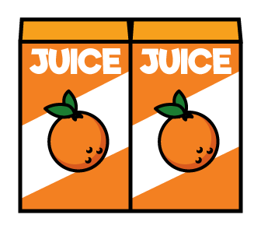
Let’s count backwards in 2s!
There were 12 boxes of juice.
After playtime the children were thirsty.

Slide 13
What is missing?
36 | 38 | 40 | ? | 44 | 46 | 48 | ?
36 | 38 | 40 | 42 | 44 | 46 | 48 | 50

